Slide 1
𐴔𐴡𐴕𐴃𐴠𐴑 𐴔𐴝𐴇𐴠𐴥𐴌𐴞𐴘𐴡𐴥𐴃𐴢 +
𐴁𐴡𐴌𐴔𐴝𐴥𐴃 𐴔𐴡𐴙𐴋𐴝𐴕𐴡𐴃 𐴓𐴝𐴔𐴞 𐴇𐴝𐴔𐴒𐴡𐴌𐴡𐴥𐴘𐴝
𐴥 𐴀𐴡𐴥𐴑𐴧𐴡𐴓𐴧𐴡𐴥𐴌 𐴓𐴝𐴥 𐴀𐴟𐴒𐴧𐴟𐴥𐴝 𐴁𐴝𐴙𐴄𐴧𐴝𐴥 𐴑𐴟𐴏
Notes:
𐴔𐴡𐴕𐴃𐴠𐴑 𐴔𐴝𐴇𐴠𐴥𐴌𐴞𐴘𐴡𐴥𐴃𐴢 + 𐴁𐴡𐴌𐴔𐴝𐴥𐴃 𐴔𐴡𐴙𐴋𐴝𐴕𐴡𐴃 𐴓𐴝𐴔𐴞 𐴇𐴝𐴔𐴒𐴡𐴌𐴡𐴥𐴘𐴝 𐴥 𐴀𐴡𐴥𐴑𐴧𐴡𐴓𐴧𐴡𐴥𐴌 𐴓𐴝𐴥 𐴀𐴟𐴒𐴧𐴟𐴥𐴝 𐴁𐴝𐴙𐴄𐴧𐴝𐴥 𐴑𐴟𐴏

Slide 2
𐴀𐴠 𐴑𐴟𐴏𐴢 𐴒𐴟𐴝𐴥 𐴊𐴠𐴥𐴑𐴞 Lotus Circle 𐴀𐴡𐴌 𐴔𐴡𐴊𐴡𐴃 𐴓𐴡𐴘 The Asia Foundation 𐴀𐴝𐴌𐴊𐴠𐴥 The Good Practice Group 𐴀𐴠𐴥 𐴕𐴠𐴓𐴝𐴘𐴧𐴠𐴥 𐴊𐴠𐴥 “Basic Psychosocial Skills: a short course for First Responders in Sri Lanka” 𐴀𐴞𐴕𐴄𐴝𐴕𐴠𐴥𐴄 𐴀𐴡𐴥𐴃 𐴐𐴞𐴥𐴑𐴝𐴊𐴠𐴥 𐴑𐴟𐴏 𐴀𐴝𐴌𐴠𐴥 𐴕𐴡𐴑𐴡𐴥𐴓 𐴒𐴡𐴌𐴞 𐴁𐴝𐴕𐴝 𐴒𐴞𐴘𐴠𐴥| 𐴏𐴞𐴥𐴌𐴞𐴥𐴓𐴡𐴥𐴛𐴑𐴝𐴥𐴌 𐴑𐴟𐴏 𐴒𐴟𐴥𐴝 (https://psychosocialskills.teachable.com/) 𐴊𐴠𐴑𐴞 Inter-Agency Standing Committee 𐴀𐴠𐴥 𐴕𐴠𐴓𐴝𐴘𐴧𐴠𐴥 𐴊𐴠𐴥 “Basic Psychosocial Skills: A Guide for COVID-19 Responders” 𐴁𐴡𐴘 𐴖𐴝𐴥𐴌𐴠𐴥 𐴕𐴡𐴑𐴡𐴥𐴓 𐴒𐴡𐴅𐴧𐴠𐴥|
𐴀𐴠 𐴃𐴡𐴌𐴅𐴟𐴔𐴝 / 𐴕𐴡𐴑𐴡𐴥𐴓 𐴒𐴡𐴅𐴧𐴝𐴥 𐴁𐴡𐴘 𐴖𐴝𐴥𐴌𐴠𐴥 Inter-Agency Standing Committee (IASC) 𐴀𐴠 𐴁𐴝𐴕𐴝𐴘𐴧𐴠𐴥 𐴊𐴠 𐴕𐴡𐴦| 𐴀𐴠 𐴃𐴡𐴌𐴅𐴟𐴔𐴝 𐴁𐴡𐴘𐴡𐴥𐴌 𐴇𐴡𐴕𐴡𐴥 𐴒𐴡𐴓𐴃𐴞 𐴊𐴠𐴑𐴞 IASC 𐴘𐴡𐴌 𐴎𐴞𐴔𐴝 𐴕𐴝𐴥𐴘| 𐴀𐴠 𐴁𐴡𐴘 𐴘𐴡𐴥𐴃 𐴀𐴝𐴌𐴡𐴥 𐴅𐴞𐴕𐴞𐴏𐴢 𐴀𐴡𐴑𐴡𐴥𐴓𐴡𐴥 𐴁𐴝𐴌𐴝𐴥𐴘 𐴀𐴠𐴏𐴃𐴠𐴔𐴝𐴓 𐴒𐴡𐴌𐴝𐴥𐴒𐴞𐴘𐴠𐴥| 𐴀𐴞𐴁𐴝𐴥𐴁 𐴔𐴟𐴓 𐴁𐴡𐴘 𐴀𐴞𐴣𐴚𐴒𐴞𐴌𐴝𐴎𐴞𐴌 𐴎𐴟𐴁𐴝𐴕𐴡𐴌 𐴒𐴟𐴥𐴝 𐴌𐴠𐴥 𐴲𐴰𐴲𐴰 𐴐𐴡𐴥𐴕𐴡𐴥𐴃 𐴔𐴝𐴎𐴠𐴥 Inter-Agency Standing Committee 𐴘𐴠 "Basic Psychosocial Skills: A Guide for COVID-19 Responders.’ 𐴕𐴝𐴔 𐴊𐴞 𐴏𐴝𐴥𐴁𐴝𐴘𐴧𐴠| (https://app.mhpss.net/resource/basic-psychosocial-skills-a-guide-for-covid-19-responders)
𐴀𐴠 𐴃𐴡𐴌𐴅𐴟𐴔𐴝 / 𐴕𐴡𐴑𐴡𐴥𐴓 𐴒𐴡𐴅𐴧𐴝𐴥 𐴁𐴡𐴘 𐴖𐴝𐴥𐴌𐴠𐴥 𐴀𐴡𐴊𐴠 𐴀𐴡𐴥𐴊𐴠 𐴔𐴟𐴓 𐴁𐴡𐴘 𐴀𐴡𐴥𐴌 𐴓𐴝𐴘𐴏𐴠𐴕 𐴀𐴡𐴃 𐴋𐴠𐴥𐴓𐴝 𐴕𐴡𐴑𐴡𐴥𐴓 𐴀𐴞𐴥𐴏𐴝𐴥𐴉𐴠 𐴏𐴝𐴥𐴁𐴝𐴒𐴞𐴘𐴠𐴥| CC BY-NC-SA 3.0 IGO (https://creativecommons.org/licenses/by-nc-sa/3.0/)
𐴀𐴠 𐴄𐴠𐴌𐴠𐴕𐴞𐴕𐴡𐴃 𐴒𐴡𐴥𐴓𐴝𐴥𐴒𐴞𐴘𐴠𐴥 𐴊𐴠𐴥 𐴏𐴝𐴥𐴁𐴝 𐴒𐴟𐴕 UNFPA Myanmar 𐴘𐴠 𐴊𐴞𐴘𐴠𐴥|
Notes:
𐴀𐴠 𐴑𐴟𐴏𐴢 𐴒𐴟𐴝𐴥 𐴊𐴠𐴥𐴑𐴞 Lotus Circle 𐴀𐴡𐴌 𐴔𐴡𐴊𐴡𐴃 𐴓𐴡𐴘 The Asia Foundation 𐴀𐴝𐴌𐴊𐴠𐴥 The Good Practice Group 𐴀𐴠𐴥 𐴕𐴠𐴓𐴝𐴘𐴧𐴠𐴥 𐴊𐴠𐴥 “Basic Psychosocial Skills: a short course for First Responders in Sri Lanka” 𐴀𐴞𐴕𐴄𐴝𐴕𐴠𐴥𐴄 𐴀𐴡𐴥𐴃 𐴐𐴞𐴥𐴑𐴝𐴊𐴠𐴥 𐴑𐴟𐴏 𐴀𐴝𐴌𐴠𐴥 𐴕𐴡𐴑𐴡𐴥𐴓 𐴒𐴡𐴌𐴞 𐴁𐴝𐴕𐴝 𐴒𐴞𐴘𐴠𐴥| 𐴏𐴞𐴥𐴌𐴞𐴥𐴓𐴡𐴥𐴛𐴑𐴝𐴥𐴌 𐴑𐴟𐴏 𐴒𐴟𐴥𐴝 (https://psychosocialskills.teachable.com/) 𐴊𐴠𐴑𐴞 Inter-Agency Standing Committee 𐴀𐴠𐴥 𐴕𐴠𐴓𐴝𐴘𐴧𐴠𐴥 𐴊𐴠𐴥 “Basic Psychosocial Skills: A Guide for COVID-19 Responders” 𐴁𐴡𐴘 𐴖𐴝𐴥𐴌𐴠𐴥 𐴕𐴡𐴑𐴡𐴥𐴓 𐴒𐴡𐴅𐴧𐴠𐴥| 𐴀𐴠 𐴃𐴡𐴌𐴅𐴟𐴔𐴝 / 𐴕𐴡𐴑𐴡𐴥𐴓 𐴒𐴡𐴅𐴧𐴝𐴥 𐴁𐴡𐴘 𐴖𐴝𐴥𐴌𐴠𐴥 Inter-Agency Standing Committee (IASC) 𐴀𐴠 𐴁𐴝𐴕𐴝𐴘𐴧𐴠𐴥 𐴊𐴠 𐴕𐴡𐴦| 𐴀𐴠 𐴃𐴡𐴌𐴅𐴟𐴔𐴝 𐴁𐴡𐴘𐴡𐴥𐴌 𐴇𐴡𐴕𐴡𐴥 𐴒𐴡𐴓𐴃𐴞 𐴊𐴠𐴑𐴞 IASC 𐴘𐴡𐴌 𐴎𐴞𐴔𐴝 𐴕𐴝𐴥𐴘| 𐴀𐴠 𐴁𐴡𐴘 𐴘𐴡𐴥𐴃 𐴀𐴝𐴌𐴡𐴥 𐴅𐴞𐴕𐴞𐴏𐴢 𐴀𐴡𐴑𐴡𐴥𐴓𐴡𐴥 𐴁𐴝𐴌𐴝𐴥𐴘 𐴀𐴠𐴏𐴃𐴠𐴔𐴝𐴓 𐴒𐴡𐴌𐴝𐴥𐴒𐴞𐴘𐴠𐴥| 𐴀𐴞𐴁𐴝𐴥𐴁 𐴔𐴟𐴓 𐴁𐴡𐴘 𐴀𐴞𐴣𐴚𐴒𐴞𐴌𐴝𐴎𐴞𐴌 𐴎𐴟𐴁𐴝𐴕𐴡𐴌 𐴒𐴟𐴥𐴝 𐴌𐴠𐴥 𐴲𐴰𐴲𐴰 𐴐𐴡𐴥𐴕𐴡𐴥𐴃 𐴔𐴝𐴎𐴠𐴥 Inter-Agency Standing Committee 𐴘𐴠 "Basic Psychosocial Skills: A Guide for COVID-19 Responders.’ 𐴕𐴝𐴔 𐴊𐴞 𐴏𐴝𐴥𐴁𐴝𐴘𐴧𐴠| (https://app.mhpss.net/resource/basic-psychosocial-skills-a-guide-for-covid-19-responders) 𐴀𐴠 𐴃𐴡𐴌𐴅𐴟𐴔𐴝 / 𐴕𐴡𐴑𐴡𐴥𐴓 𐴒𐴡𐴅𐴧𐴝𐴥 𐴁𐴡𐴘 𐴖𐴝𐴥𐴌𐴠𐴥 𐴀𐴡𐴊𐴠 𐴀𐴡𐴥𐴊𐴠 𐴔𐴟𐴓 𐴁𐴡𐴘 𐴀𐴡𐴥𐴌 𐴓𐴝𐴘𐴏𐴠𐴕 𐴀𐴡𐴃 𐴋𐴠𐴥𐴓𐴝 𐴕𐴡𐴑𐴡𐴥𐴓 𐴀𐴞𐴥𐴏𐴝𐴥𐴉𐴠 𐴏𐴝𐴥𐴁𐴝𐴒𐴞𐴘𐴠𐴥| CC BY-NC-SA 3.0 IGO (https://creativecommons.org/licenses/by-nc-sa/3.0/) 𐴀𐴠 𐴄𐴠𐴌𐴠𐴕𐴞𐴕𐴡𐴃 𐴒𐴡𐴥𐴓𐴝𐴥𐴒𐴞𐴘𐴠𐴥 𐴊𐴠𐴥 𐴏𐴝𐴥𐴁𐴝 𐴒𐴟𐴕 UNFPA Myanmar 𐴘𐴠 𐴊𐴞𐴘𐴠𐴥|

Slide 3
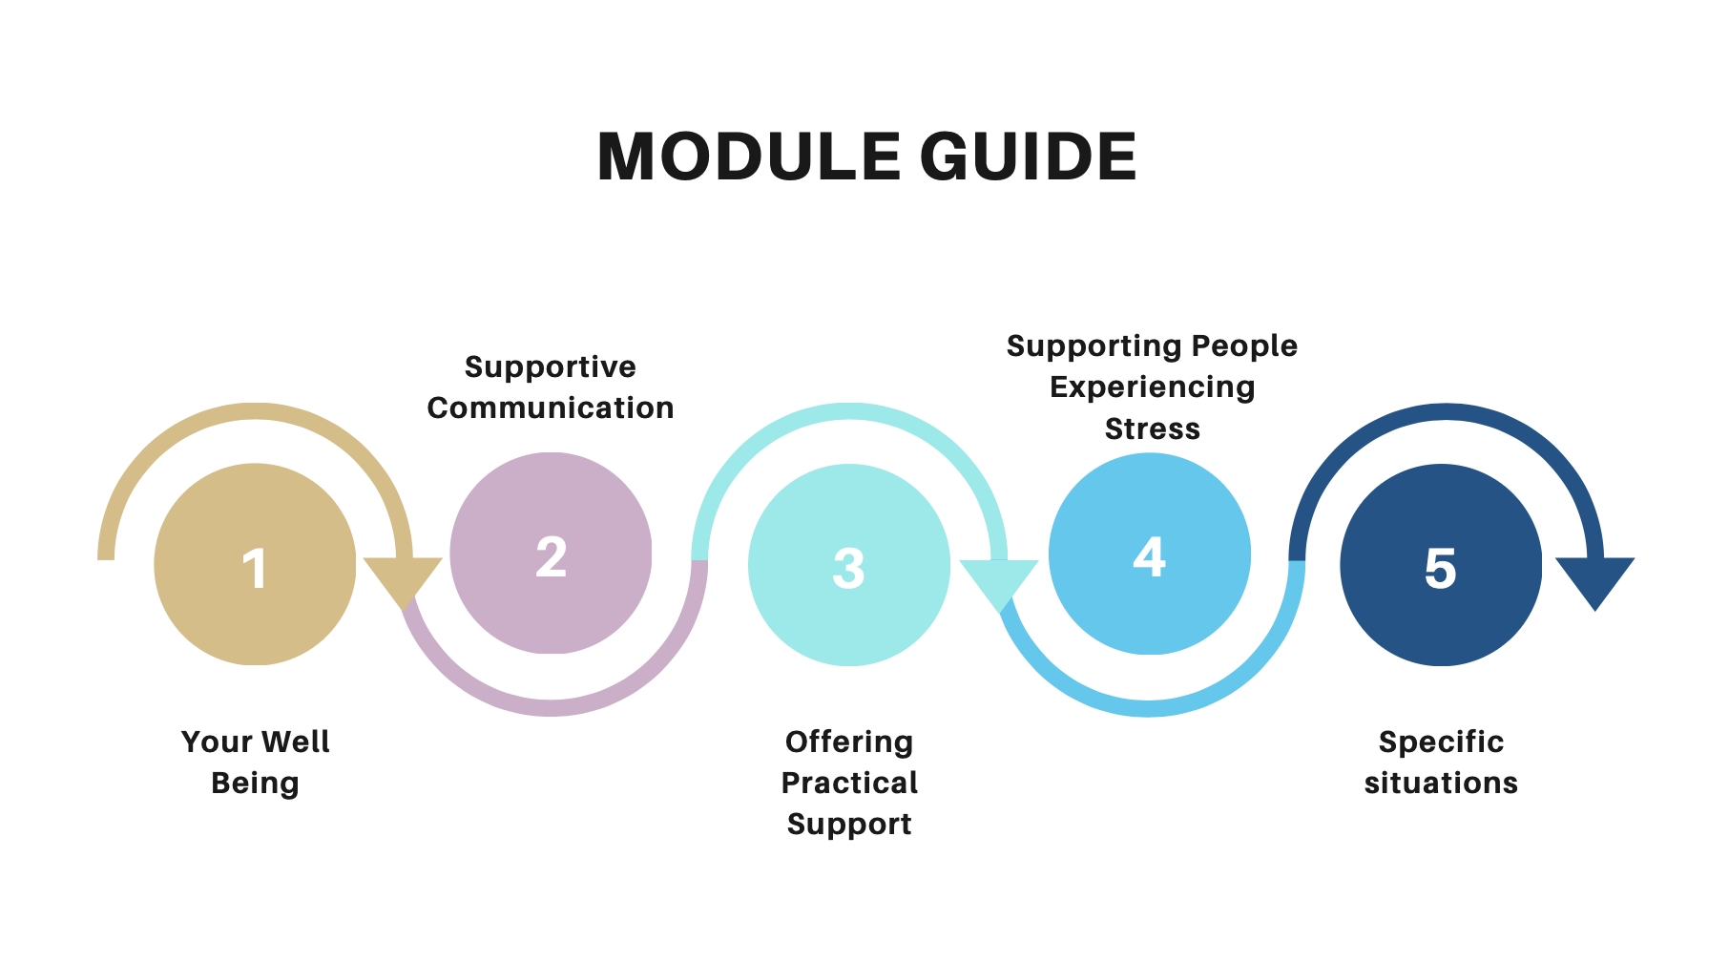
Notes:
𐴀𐴠𐴑𐴟𐴏𐴧𐴡𐴃𐴢𐴵 module𐴀𐴝𐴏𐴠 𐴀𐴠𐴥𐴈𐴡𐴃𐴝𐴒𐴞𐴕𐴡𐴌𐴠 𐴐𐴟𐴌𐴟𐴓𐴡𐴃𐴝 𐴐𐴝𐴅𐴝𐴒𐴞𐴘𐴠𐴊𐴠 𐴔𐴡𐴌𐴔𐴝𐴥𐴃𐴢𐴔𐴡𐴙𐴘𐴊𐴝𐴕𐴡𐴃𐴢 𐴓𐴝𐴔𐴞 𐴇𐴝𐴏𐴒𐴡𐴌𐴡𐴙𐴘𐴧𐴝 𐴀𐴡𐴑𐴧𐴡𐴓𐴠 𐴃𐴡𐴅𐴟𐴌𐴟𐴁𐴝𐴌𐴠 𐴑𐴡𐴔𐴧𐴡𐴓𐴝 𐴀𐴠𐴏𐴢𐴃𐴡𐴔𐴝𐴓 𐴒𐴡𐴌𐴞 𐴉𐴝𐴌𐴞𐴁𐴡𐴥

Slide 4
𐴏𐴡𐴥𐴖𐴑𐴢 𐴊𐴝𐴤𐴇𐴝𐴔𐴡𐴊𐴡𐴊𐴢 𐴒𐴡𐴌𐴝
𐴳.𐴱 𐴉𐴡𐴤𐴘𐴓𐴝𐴙𐴐𐴧𐴟𐴤𐴌𐴟𐴃𐴢 𐴈𐴡𐴥𐴁𐴡𐴌𐴢𐴀𐴝𐴊𐴧𐴠
𐴅𐴞𐴕𐴞𐴐𐴢𐴀𐴡𐴥𐴑𐴧𐴡𐴓𐴢𐴊𐴞𐴘𐴝
𐴀𐴡𐴕𐴝𐴌𐴝𐴌𐴠𐴳module𐴃𐴡𐴌𐴥 𐴉𐴡𐴃𐴧𐴟𐴕 𐴀𐴠𐴏𐴃𐴡𐴑𐴁𐴝𐴓𐴒𐴡𐴌𐴝𐴅𐴝𐴌
Notes:
𐴏𐴡𐴥𐴖𐴑𐴢 𐴊𐴝𐴤𐴇𐴝𐴔𐴡𐴊𐴡𐴊𐴢 𐴒𐴡𐴌𐴝 𐴳.𐴱 𐴉𐴡𐴤𐴘𐴓𐴝𐴙𐴐𐴧𐴟𐴤𐴌𐴟𐴃𐴢 𐴈𐴡𐴥𐴁𐴡𐴌𐴢𐴀𐴝𐴊𐴧𐴠 𐴅𐴞𐴕𐴞𐴐𐴢𐴀𐴡𐴥𐴑𐴧𐴡𐴓𐴢𐴊𐴞𐴘𐴝 𐴀𐴡𐴕𐴝𐴌𐴝𐴌𐴠𐴳module𐴃𐴡𐴌𐴥 𐴉𐴡𐴃𐴧𐴟𐴕 𐴀𐴠𐴏𐴃𐴡𐴑𐴁𐴝𐴓𐴒𐴡𐴌𐴝𐴅𐴝𐴌 5.

Slide 5
𐴏𐴡𐴘𐴞𐴇𐴝𐴓𐴡𐴃𐴧𐴡𐴌 𐴀𐴡𐴌𐴠 𐴔𐴝𐴣𐴕𐴐𐴡𐴌𐴠 𐴔𐴡𐴊𐴡𐴃𐴒𐴡𐴌𐴡𐴕
Notes:
𐴏𐴡𐴘𐴞𐴇𐴝𐴓𐴡𐴃𐴧𐴡𐴌 𐴀𐴡𐴌𐴠 𐴔𐴝𐴣𐴕𐴐𐴡𐴌𐴠 𐴔𐴡𐴊𐴡𐴃𐴒𐴡𐴌𐴡𐴕

Slide 6
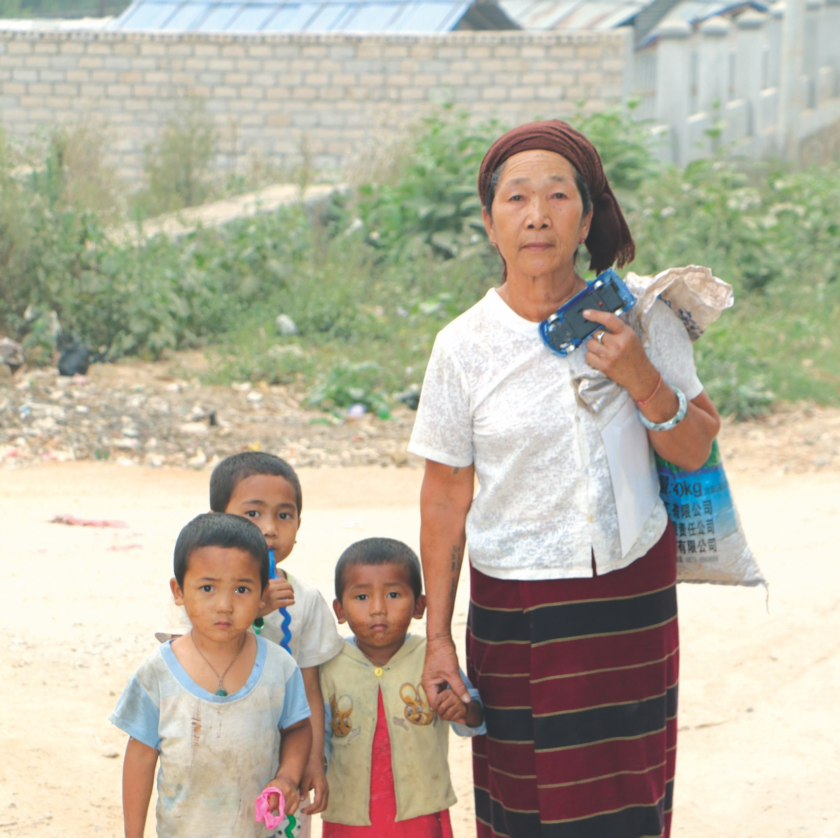
𐴔𐴝𐴙𐴕𐴐𐴡𐴌𐴥 𐴁𐴟𐴃𐴡𐴥𐴌𐴠 𐴁𐴞𐴐𐴞𐴥 𐴑𐴡𐴔𐴎𐴟𐴌𐴞𐴘𐴡𐴃𐴢,𐴀𐴡𐴐𐴝𐴕𐴥𐴃𐴞𐴃𐴀𐴝𐴏𐴠𐴊𐴠 𐴀𐴞𐴕𐴊𐴞𐴓𐴧𐴝 𐴔𐴝𐴙𐴕𐴐𐴡𐴌𐴠 𐴄𐴞𐴑𐴥𐴇𐴝𐴓𐴡𐴃𐴧𐴡𐴌 𐴀𐴡𐴌𐴠 𐴌𐴝𐴑𐴝𐴉𐴡𐴌𐴞𐴁𐴡
Notes:
𐴔𐴝𐴙𐴕𐴐𐴡𐴌𐴥 𐴁𐴟𐴃𐴡𐴥𐴌𐴠 𐴁𐴞𐴐𐴞𐴥 𐴑𐴡𐴔𐴎𐴟𐴌𐴞𐴘𐴡𐴃𐴢,𐴀𐴡𐴐𐴝𐴕𐴥𐴃𐴞𐴃𐴀𐴝𐴏𐴠𐴊𐴠 𐴀𐴞𐴕𐴊𐴞𐴓𐴧𐴝 𐴔𐴝𐴙𐴕𐴐𐴡𐴌𐴠 𐴄𐴞𐴑𐴥𐴇𐴝𐴓𐴡𐴃𐴧𐴡𐴌 𐴀𐴡𐴌𐴠 𐴌𐴝𐴑𐴝𐴉𐴡𐴌𐴞𐴁𐴡

Slide 7
𐴇𐴝𐴄𐴞 𐴒𐴡𐴌𐴝𐴉𐴡𐴌𐴞𐴁𐴡 𐴀𐴡𐴐𐴝𐴕𐴃𐴞 𐴀𐴝𐴏𐴠𐴊𐴞 𐴇𐴞𐴕𐴊𐴞𐴓𐴧𐴝 𐴔𐴝𐴙𐴕𐴐𐴡𐴌𐴠 𐴀𐴞𐴕𐴐𐴝 𐴕𐴡𐴒𐴡𐴌𐴞 𐴁𐴡𐴙𐴓𐴧𐴧𐴧𐴧𐴧𐴝

Slide 8
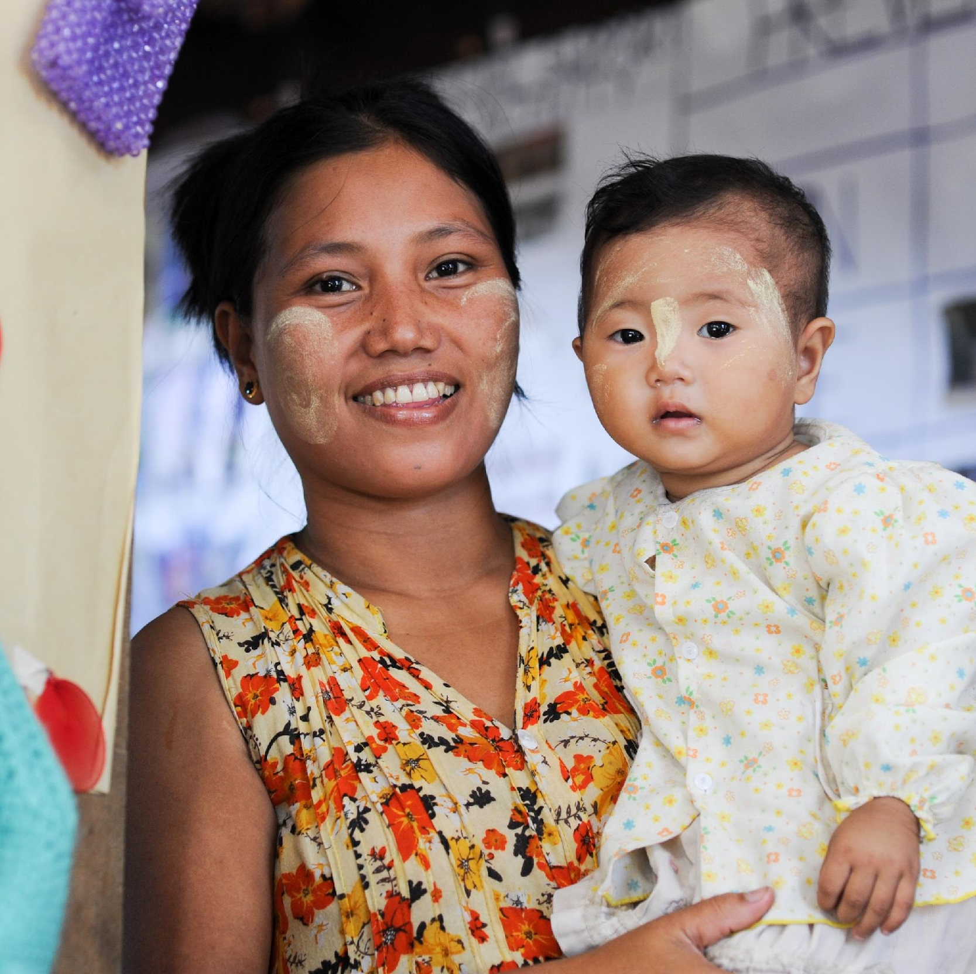
𐴒𐴡𐴄𐴝𐴕𐴝𐴙𐴌 𐴀𐴡𐴐𐴝𐴙𐴕𐴃𐴞𐴃 𐴀𐴝𐴏𐴠𐴊𐴠 𐴇𐴞𐴕𐴊𐴞𐴓𐴧𐴝 𐴔𐴝𐴙𐴕𐴐𐴡𐴃𐴧𐴡𐴕 𐴀𐴝𐴇𐴡𐴙𐴓 𐴄𐴞𐴑𐴥𐴓𐴝𐴑𐴝𐴦𐴉𐴡𐴌𐴞𐴁𐴡𐴥
Notes:
𐴒𐴡𐴄𐴝𐴕𐴝𐴙𐴌 𐴀𐴡𐴐𐴝𐴙𐴕𐴃𐴞𐴃 𐴀𐴝𐴏𐴠𐴊𐴠 𐴇𐴞𐴕𐴊𐴞𐴓𐴧𐴝 𐴔𐴝𐴙𐴕𐴐𐴡𐴃𐴧𐴡𐴕 𐴀𐴝𐴇𐴡𐴙𐴓 𐴄𐴞𐴑𐴥𐴓𐴝𐴑𐴝𐴦𐴉𐴡𐴌𐴞𐴁𐴡𐴥

Slide 9
𐴈𐴝𐴙𐴌𐴢𐴀𐴠𐴙𐴑𐴧𐴝𐴕 𐴑𐴡𐴔𐴎𐴟𐴌𐴞𐴘𐴡𐴃 𐴊𐴝𐴇𐴝𐴕𐴡𐴦𐴎𐴝 𐴇𐴠𐴃𐴝𐴓𐴧 𐴅𐴟𐴖𐴝𐴁𐴥𐴢 𐴊𐴡𐴕𐴧𐴝𐴕 𐴎𐴟𐴌𐴟𐴌𐴞𐴥
Notes:
𐴈𐴝𐴙𐴌𐴢𐴀𐴠𐴙𐴑𐴧𐴝𐴕 𐴑𐴡𐴔𐴎𐴟𐴌𐴞𐴘𐴡𐴃 𐴊𐴝𐴇𐴝𐴕𐴡𐴦𐴎𐴝 𐴇𐴠𐴃𐴝𐴓𐴧 𐴅𐴟𐴖𐴝𐴁𐴥𐴢 𐴊𐴡𐴕𐴧𐴝𐴕 𐴎𐴟𐴌𐴟𐴌𐴞𐴥

Slide 10
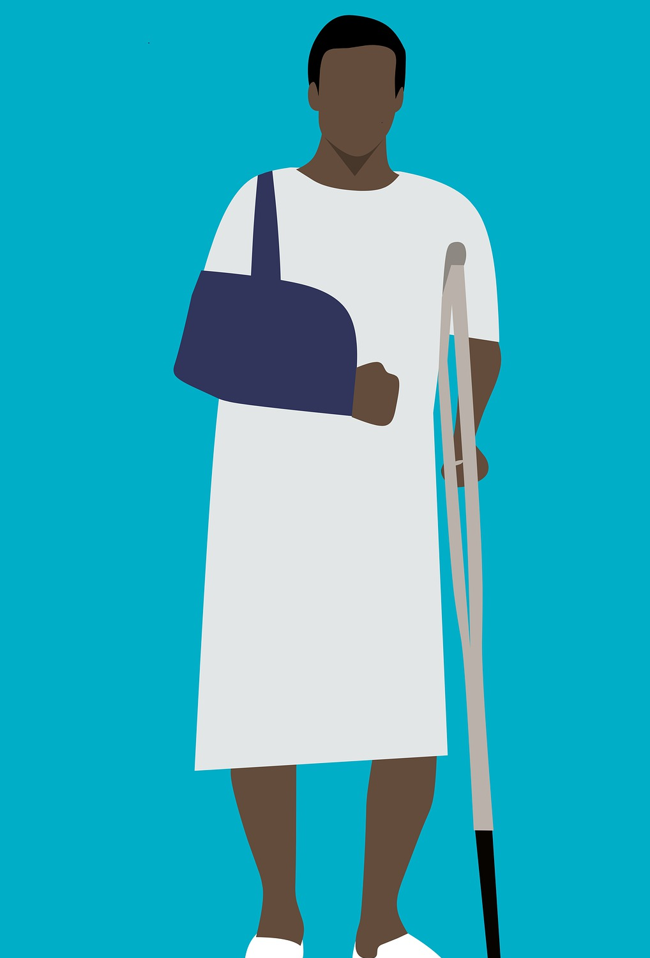
𐴇𐴝𐴌𐴀𐴠𐴑𐴥 𐴎𐴡𐴕𐴡𐴌 𐴀𐴡𐴐𐴝𐴕𐴃𐴞𐴌 𐴇𐴝𐴓𐴡𐴃𐴥 𐴃𐴝𐴑𐴞𐴃𐴢 𐴉𐴝𐴌𐴠

Slide 11
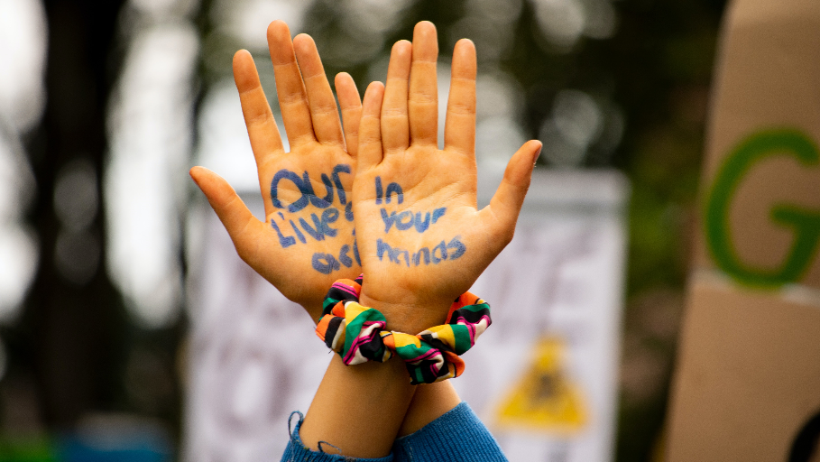
𐴑𐴞𐴏𐴧𐴟 𐴔𐴝𐴕𐴟𐴙𐴐 𐴀𐴡𐴐𐴝𐴙𐴕𐴃𐴞𐴃 𐴉𐴡𐴌𐴞𐴊𐴉𐴝𐴌𐴠 𐴊𐴞𐴐𐴞𐴃𐴧𐴝𐴌𐴢 𐴇𐴡𐴑𐴓𐴡𐴙𐴘𐴧𐴡𐴌𐴠
Notes:
𐴑𐴞𐴏𐴧𐴟 𐴔𐴝𐴕𐴟𐴙𐴐 𐴀𐴡𐴐𐴝𐴙𐴕𐴃𐴞𐴃 𐴉𐴡𐴌𐴞𐴊𐴉𐴝𐴌𐴠 𐴊𐴞𐴐𐴞𐴃𐴧𐴝𐴌𐴢 𐴇𐴡𐴑𐴓𐴡𐴙𐴘𐴧𐴡𐴌𐴠

Slide 12
Module 5
𐴀𐴡𐴐𐴝𐴕𐴃𐴞𐴌𐴢 𐴋𐴝𐴙𐴘
Notes:
𐴀𐴡𐴐𐴝𐴕𐴃𐴞𐴌𐴢 𐴋𐴝𐴙𐴘 𐴀𐴠𐴑𐴧𐴝𐴐𐴝𐴙𐴘

Slide 13
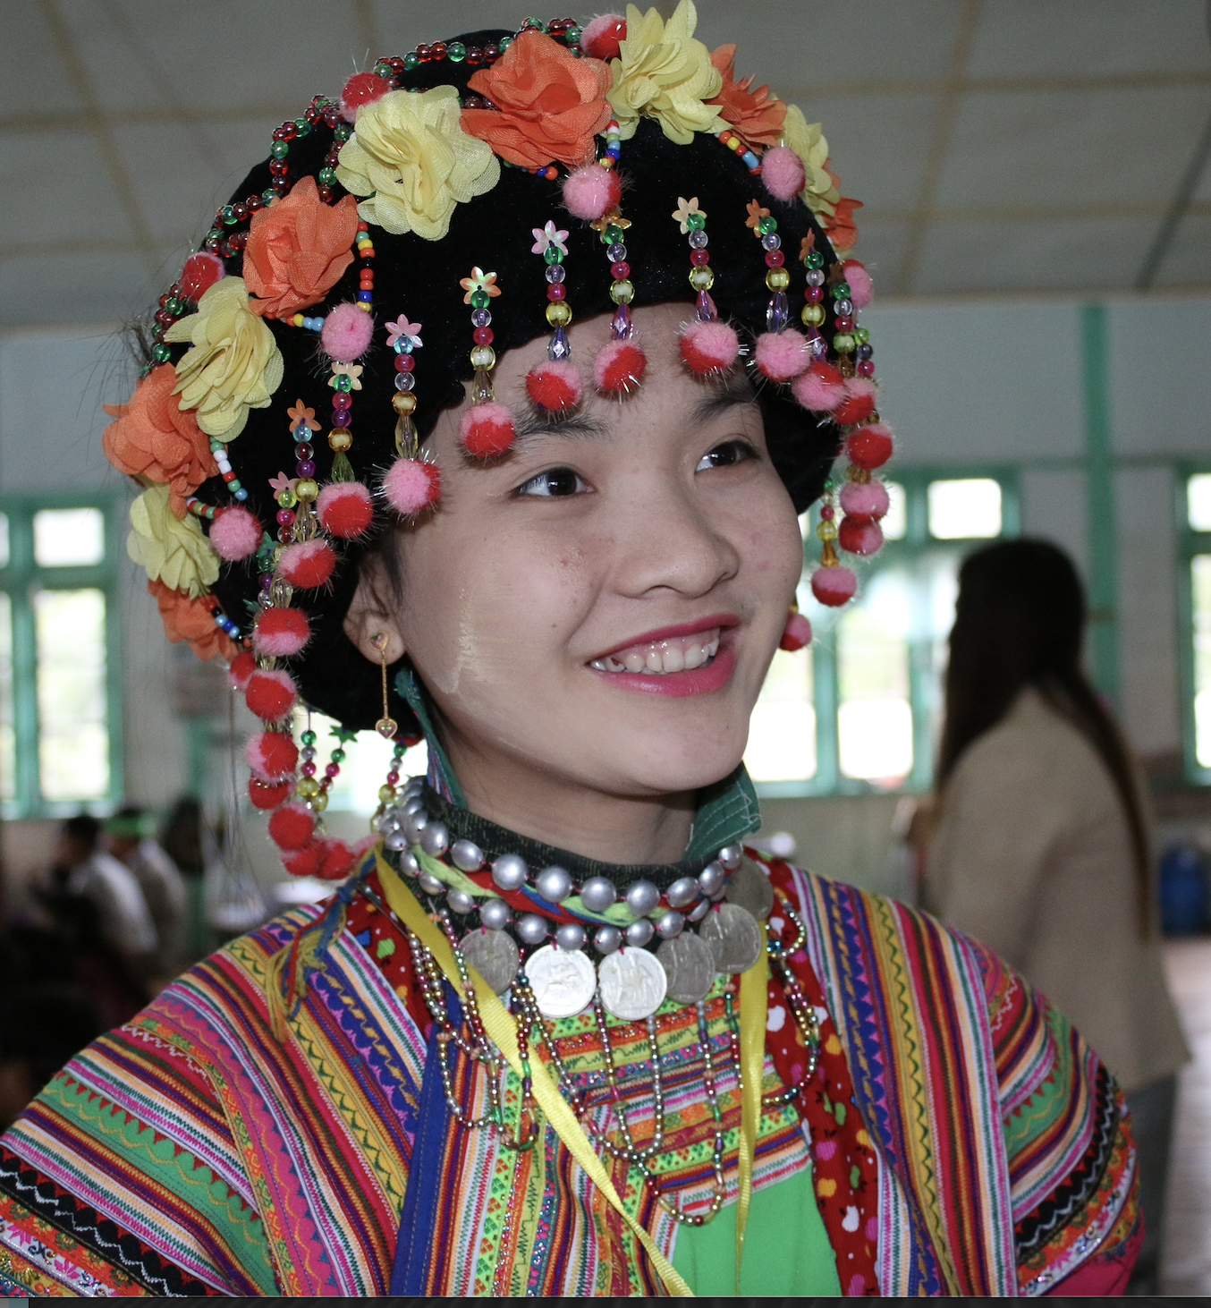
𐴀𐴡𐴐𐴝𐴙𐴕𐴃𐴞𐴌𐴢 𐴔𐴝𐴕𐴟𐴙𐴐 𐴀𐴝𐴌𐴥 𐴋𐴝𐴙𐴘𐴢
𐴇𐴡𐴣𐴕 𐴐𐴡𐴙𐴣𐴒𐴝𐴙𐴘 𐴔𐴝𐴙𐴕𐴐𐴡𐴌𐴠 𐴇𐴝𐴔𐴡𐴃𐴧𐴟𐴕 𐴔𐴝𐴌𐴡𐴕 𐴒𐴡𐴌𐴠𐴥𐴥𐴥 𐴀𐴝𐴌𐴥 𐴃𐴝𐴌𐴝𐴁𐴠𐴙𐴐 𐴔𐴝𐴙𐴕𐴐𐴡𐴌 𐴈𐴡𐴃𐴝 𐴕𐴡𐴎𐴝𐴕𐴠𐴦

Slide 14
𐴁𐴡𐴐𐴡𐴁𐴝𐴙𐴐 𐴒𐴡𐴌𐴡𐴙𐴘𐴧𐴝𐴌 𐴀𐴞𐴎𐴧𐴡𐴃𐴡𐴌𐴢 𐴓𐴟𐴏𐴧𐴝𐴕 𐴒𐴡𐴌𐴝
𐴒𐴡𐴄𐴝𐴕𐴝𐴌 𐴇𐴝𐴓𐴡𐴃𐴡𐴃 𐴔𐴝𐴘𐴙𐴝𐴉𐴟𐴖𐴝𐴙𐴕𐴊𐴡𐴌 𐴀𐴞𐴎𐴡𐴃𐴧𐴡𐴌 𐴓𐴟𐴏𐴝𐴕 𐴒𐴡𐴌𐴝
Notes:
𐴁𐴡𐴐𐴡𐴁𐴝𐴙𐴐 𐴒𐴡𐴌𐴡𐴙𐴘𐴧𐴝𐴌 𐴀𐴞𐴎𐴧𐴡𐴃𐴡𐴌𐴢 𐴓𐴟𐴏𐴧𐴝𐴕 𐴒𐴡𐴌𐴝 𐴒𐴡𐴄𐴝𐴕𐴝𐴌 𐴇𐴝𐴓𐴡𐴃𐴡𐴃 𐴔𐴝𐴘𐴙𐴝𐴉𐴟𐴖𐴝𐴙𐴕𐴊𐴡𐴌 𐴀𐴞𐴎𐴡𐴃𐴧𐴡𐴌 𐴓𐴟𐴏𐴝𐴕 𐴒𐴡𐴌𐴝

Slide 15
THE LGBTQI
𐴑𐴡𐴔𐴥
𐴔𐴡𐴌𐴊𐴝𐴕𐴞 𐴕𐴙𐴝𐴘𐴊𐴠 𐴔𐴝𐴙𐴕𐴐𐴡𐴌𐴠 𐴇𐴝𐴔𐴡𐴃𐴧𐴟𐴕 𐴁𐴝𐴙𐴊𐴧𐴞𐴘𐴝𐴎𐴝𐴦 𐴀𐴝𐴌𐴥 𐴑𐴡𐴙𐴔𐴧𐴡𐴙𐴃𐴧𐴟𐴕 𐴈𐴡𐴔𐴊𐴝𐴇𐴝𐴎𐴝
Notes:
LGBTQI Community- 𐴔𐴡𐴌𐴊𐴝𐴕𐴞 𐴕𐴙𐴝𐴘𐴊𐴠 𐴔𐴝𐴙𐴕𐴐𐴡𐴌𐴠 𐴇𐴝𐴔𐴡𐴃𐴧𐴟𐴕 𐴁𐴝𐴙𐴊𐴧𐴞𐴘𐴝𐴎𐴝𐴦 𐴀𐴝𐴌𐴥 𐴑𐴡𐴙𐴔𐴧𐴡𐴙𐴃𐴧𐴟𐴕 𐴈𐴡𐴔𐴊𐴝𐴇𐴝𐴎𐴝

Slide 16
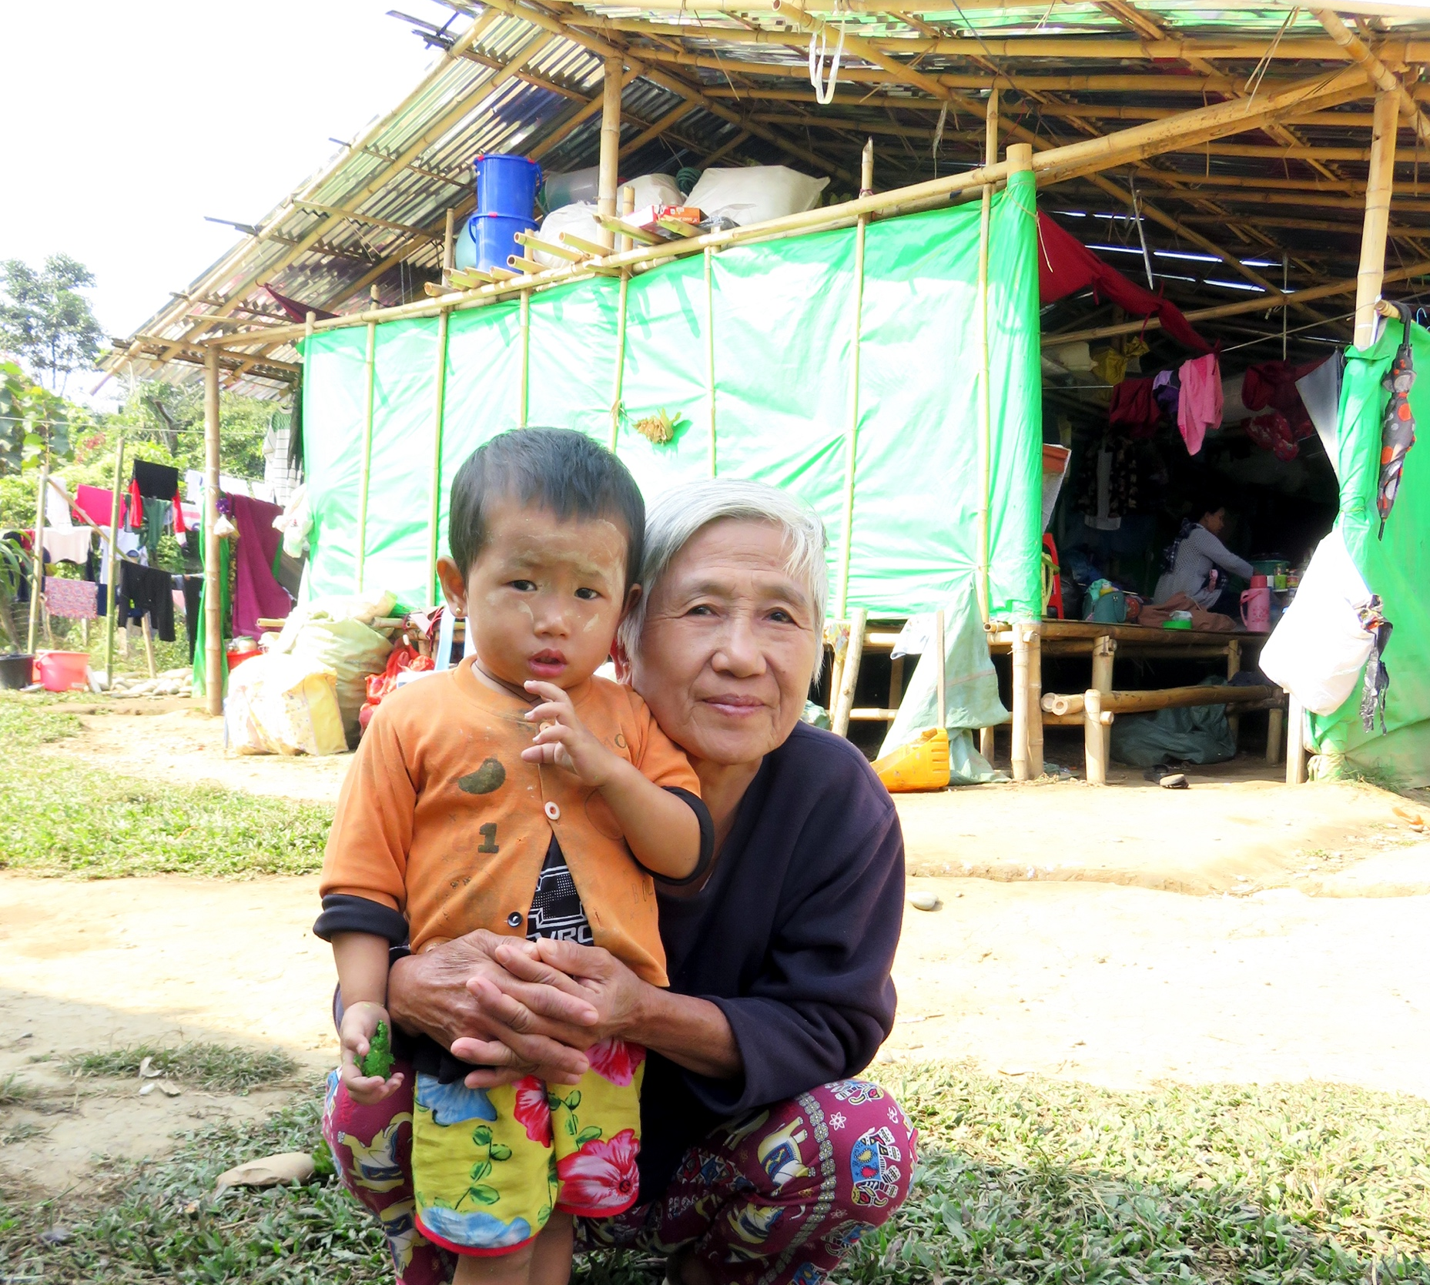
𐴇𐴞𐴎𐴡𐴌𐴡𐴃𐴢 𐴀𐴝𐴌𐴥 𐴌𐴞𐴉𐴟𐴎𐴞
𐴃𐴟𐴖𐴝𐴙𐴌 𐴊𐴠𐴐𐴡𐴃 𐴀𐴝𐴐𐴠𐴊𐴠 𐴌𐴞𐴉𐴟𐴎𐴞 𐴏𐴝𐴣𐴌𐴝𐴓𐴡𐴘𐴁𐴡𐴙𐴓𐴧𐴝
𐴃𐴝𐴌𐴝 𐴔𐴡𐴑𐴝 𐴕𐴡𐴉𐴙𐴝𐴘𐴃𐴉𐴝𐴌𐴠
Notes:
𐴇𐴞𐴎𐴡𐴌𐴡𐴃𐴢 𐴀𐴝𐴌𐴥 𐴌𐴞𐴉𐴟𐴎𐴞 𐴃𐴟𐴖𐴝𐴙𐴌 𐴊𐴠𐴐𐴡𐴃 𐴀𐴝𐴐𐴠𐴊𐴠 𐴌𐴞𐴉𐴟𐴎𐴞 𐴏𐴝𐴣𐴌𐴝𐴓𐴡𐴘𐴁𐴡𐴙𐴓𐴧𐴝 𐴃𐴝𐴌𐴝 𐴔𐴡𐴑𐴝 𐴕𐴡𐴉𐴙𐴝𐴘𐴃𐴉𐴝𐴌𐴠

Slide 17
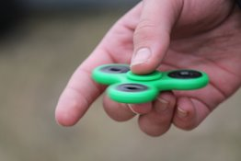
𐴇𐴝𐴏 𐴒𐴡𐴌𐴞 𐴊𐴞𐴓𐴡𐴌 𐴀𐴞𐴓𐴙𐴝𐴐 𐴀𐴝𐴌𐴥 𐴁𐴝𐴉𐴝𐴏𐴞𐴕𐴃𐴝𐴌𐴢 𐴀𐴠𐴓𐴙𐴝𐴐 𐴓𐴝𐴒𐴠𐴊𐴠 𐴔𐴝𐴕𐴟𐴙𐴐𐴦𐴦
𐴔𐴡𐴊𐴡𐴃 𐴓𐴝𐴒𐴠𐴊𐴠 𐴔𐴝𐴙𐴕𐴐𐴡𐴌𐴠 𐴎𐴝𐴓𐴙𐴝𐴘𐴁𐴡𐴦 𐴃𐴝𐴌𐴝𐴌 𐴇𐴝𐴔𐴡𐴊
Notes:
𐴇𐴝𐴏 𐴒𐴡𐴌𐴞 𐴊𐴞𐴓𐴡𐴌 𐴀𐴞𐴓𐴙𐴝𐴐 𐴀𐴝𐴌𐴥 𐴁𐴝𐴉𐴝𐴏𐴞𐴕𐴃𐴝𐴌𐴢 𐴀𐴠𐴓𐴙𐴝𐴐 𐴓𐴝𐴒𐴠𐴊𐴠 𐴔𐴝𐴕𐴟𐴙𐴐𐴦𐴦 𐴔𐴡𐴊𐴡𐴃 𐴓𐴝𐴒𐴠𐴊𐴠 𐴔𐴝𐴙𐴕𐴐𐴡𐴌𐴠 𐴎𐴝𐴓𐴙𐴝𐴘𐴁𐴡𐴦 𐴃𐴝𐴌𐴝𐴌 𐴇𐴝𐴔𐴡𐴊

Slide 18
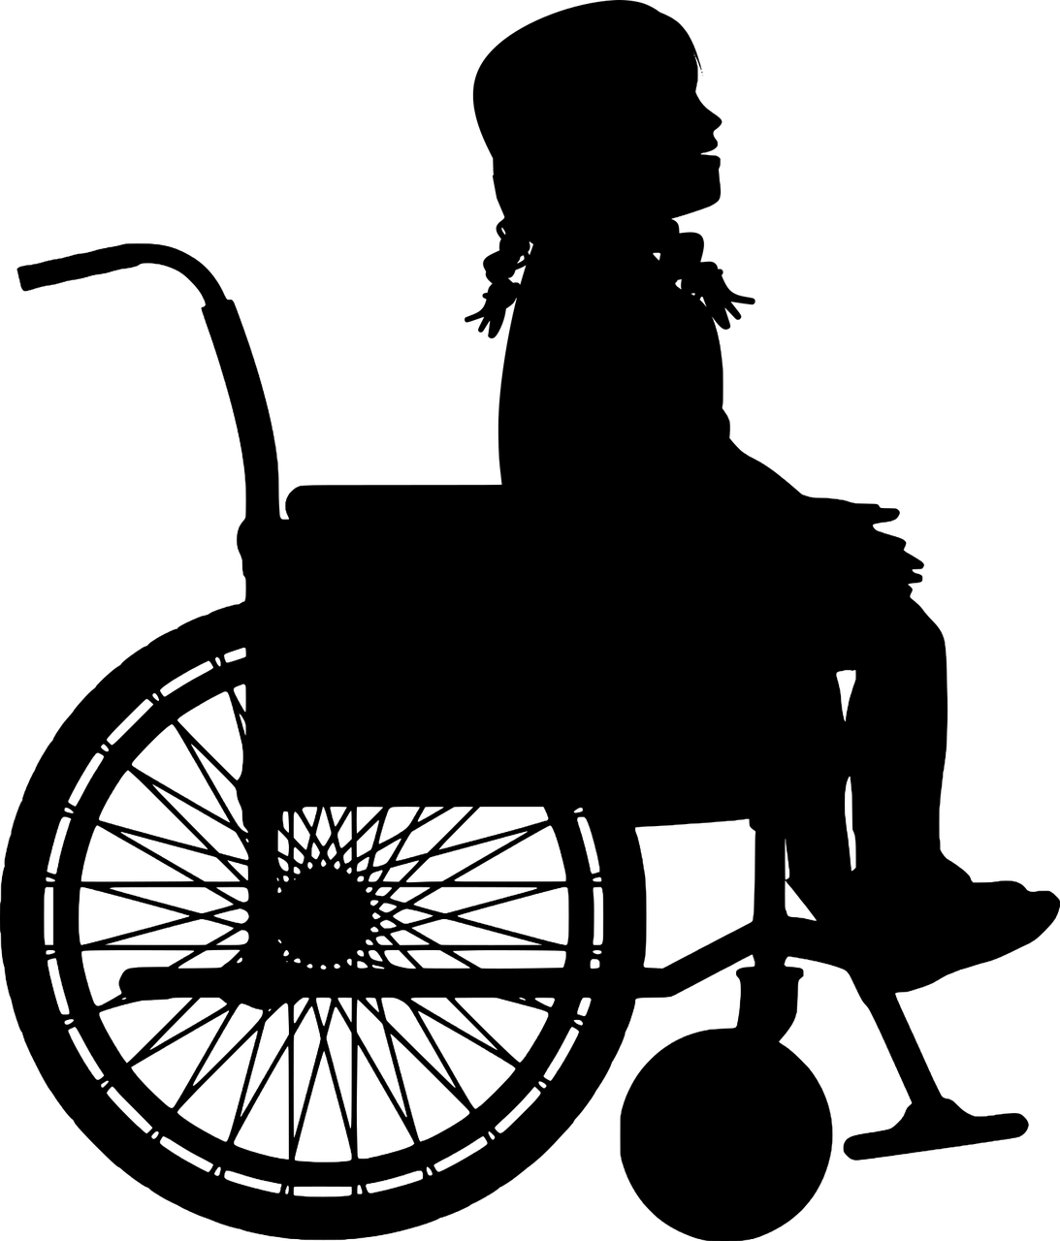
𐴔𐴝𐴎𐴟𐴌 𐴔𐴝𐴕𐴙𐴝𐴐𐴥
𐴔𐴝𐴎𐴟𐴌 𐴔𐴝𐴕𐴙𐴝𐴐 𐴀𐴡𐴑𐴧𐴡𐴓𐴡𐴃𐴧𐴟𐴕 𐴇𐴝𐴄𐴞 𐴇𐴡𐴁𐴡𐴌 𐴇𐴝𐴄𐴞𐴏𐴞𐴏 𐴓𐴝𐴒𐴠𐴥
Notes:
𐴔𐴝𐴎𐴟𐴌 𐴔𐴝𐴕𐴙𐴝𐴐 𐴀𐴡𐴑𐴧𐴡𐴓𐴡𐴃𐴧𐴟𐴕 𐴇𐴝𐴄𐴞 𐴇𐴡𐴁𐴡𐴌 𐴇𐴝𐴄𐴞𐴏𐴞𐴏 𐴓𐴝𐴒𐴠𐴥

Slide 19
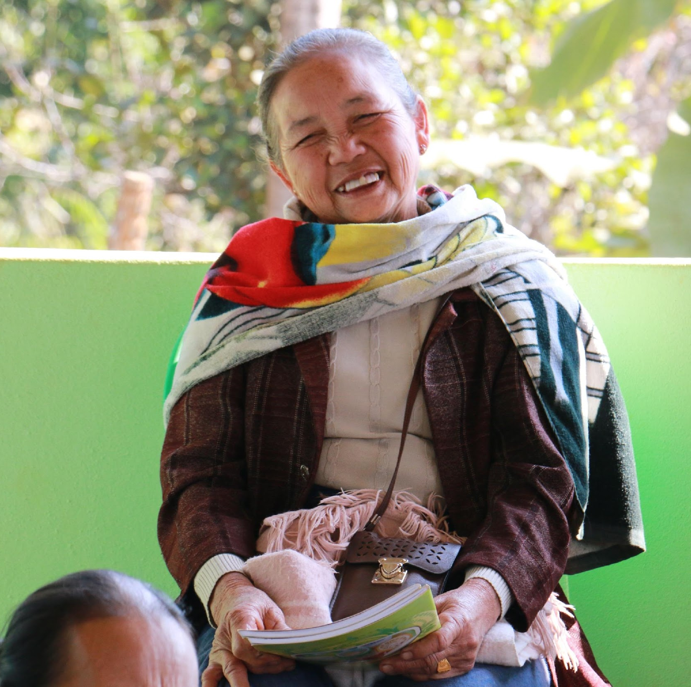
𐴀𐴝𐴔𐴡𐴕 𐴀𐴡𐴓𐴝 𐴒𐴡𐴌𐴡𐴃𐴥𐴢 𐴃𐴝𐴑𐴠𐴊𐴠 𐴔𐴝𐴕𐴟𐴙𐴐
𐴀𐴠𐴑𐴠𐴓𐴝𐴦 𐴒𐴡𐴌𐴡𐴃𐴧𐴝𐴑𐴠𐴓𐴙𐴠 𐴀𐴡𐴐𐴝𐴕𐴃𐴞 𐴓𐴝𐴒𐴠 𐴊𐴟𐴕𐴞𐴘𐴝𐴌 𐴇𐴡𐴁𐴡𐴌𐴥 𐴉𐴟𐴕𐴞𐴓𐴠 𐴒𐴡𐴔𐴕𐴡𐴓𐴝𐴒𐴠
Notes:
𐴀𐴝𐴔𐴡𐴕 𐴀𐴡𐴓𐴝 𐴒𐴡𐴌𐴡𐴃𐴥𐴢 𐴃𐴝𐴑𐴠𐴊𐴠 𐴔𐴝𐴕𐴟𐴙𐴐 𐴀𐴠𐴑𐴠𐴓𐴝𐴦 𐴒𐴡𐴌𐴡𐴃𐴧𐴝𐴑𐴠𐴓𐴙𐴠 𐴀𐴡𐴐𐴝𐴕𐴃𐴞 𐴓𐴝𐴒𐴠 𐴊𐴟𐴕𐴞𐴘𐴝𐴌 𐴇𐴡𐴁𐴡𐴌𐴥 𐴉𐴟𐴕𐴞𐴓𐴠 𐴒𐴡𐴔𐴕𐴡𐴓𐴝𐴒𐴠

Slide 20
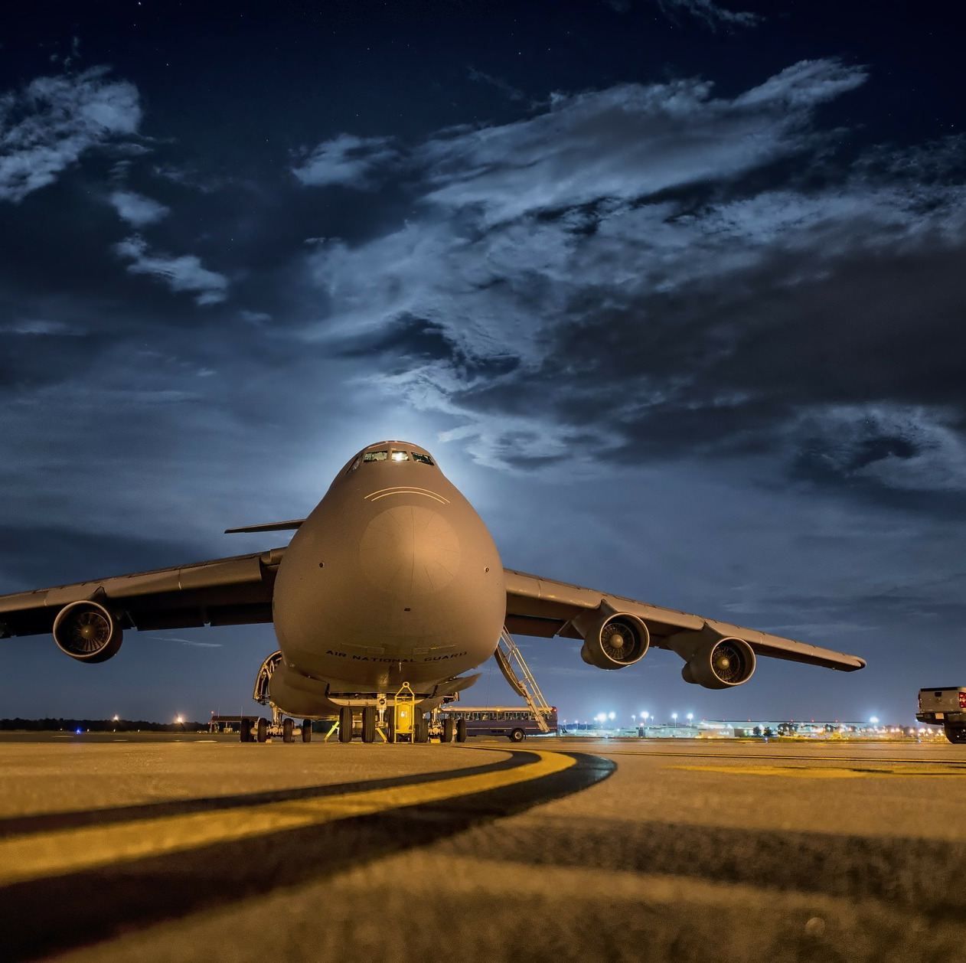
𐴁𐴞𐴊𐴠𐴙𐴐𐴧𐴡𐴃𐴧𐴟𐴕𐴦 𐴖𐴝𐴉𐴠𐴏𐴢 𐴀𐴝𐴘𐴠𐴊𐴧𐴠 𐴌𐴞𐴉𐴟𐴎𐴞𐴥
𐴁𐴞𐴊𐴠𐴙𐴐𐴧𐴡𐴃𐴧𐴟𐴕 𐴀𐴝𐴘𐴠𐴊𐴠 𐴀𐴞𐴕𐴡𐴌𐴠 𐴉𐴡𐴌𐴡𐴑 𐴒𐴡𐴌𐴠 𐴀𐴝𐴌𐴥 𐴃𐴝𐴌𐴝𐴃𐴧𐴟𐴕 𐴀𐴡𐴐𐴝𐴕𐴃𐴞 𐴓𐴝𐴒𐴠

Slide 21
𐴐𐴟𐴁𐴝𐴒𐴡𐴌𐴞𐴥 𐴑𐴟𐴌𐴟𐴕𐴝 𐴁𐴞𐴘𐴝𐴌𐴝𐴔𐴡𐴃𐴧𐴟𐴕 𐴔𐴝𐴕𐴟𐴙𐴐
𐴀𐴝𐴓𐴝𐴊𐴝 𐴒𐴡𐴌𐴞 𐴓𐴠𐴙𐴑𐴧𐴠𐴊𐴠 𐴔𐴝𐴕𐴐𐴡𐴙𐴃𐴧𐴟𐴕 𐴀𐴡𐴐𐴝𐴕𐴃𐴞𐴓𐴝𐴒𐴠
Notes:
𐴐𐴟𐴁𐴝𐴒𐴡𐴌𐴞𐴥 𐴑𐴟𐴌𐴟𐴕𐴝 𐴁𐴞𐴘𐴝𐴌𐴝𐴔𐴡𐴃𐴧𐴟𐴕 𐴔𐴝𐴕𐴟𐴙𐴐 𐴀𐴝𐴓𐴝𐴊𐴝 𐴒𐴡𐴌𐴞 𐴓𐴠𐴙𐴑𐴧𐴠𐴊𐴠 𐴔𐴝𐴕𐴐𐴡𐴙𐴃𐴧𐴟𐴕 𐴀𐴡𐴐𐴝𐴕𐴃𐴞𐴓𐴝𐴒𐴠

Slide 22
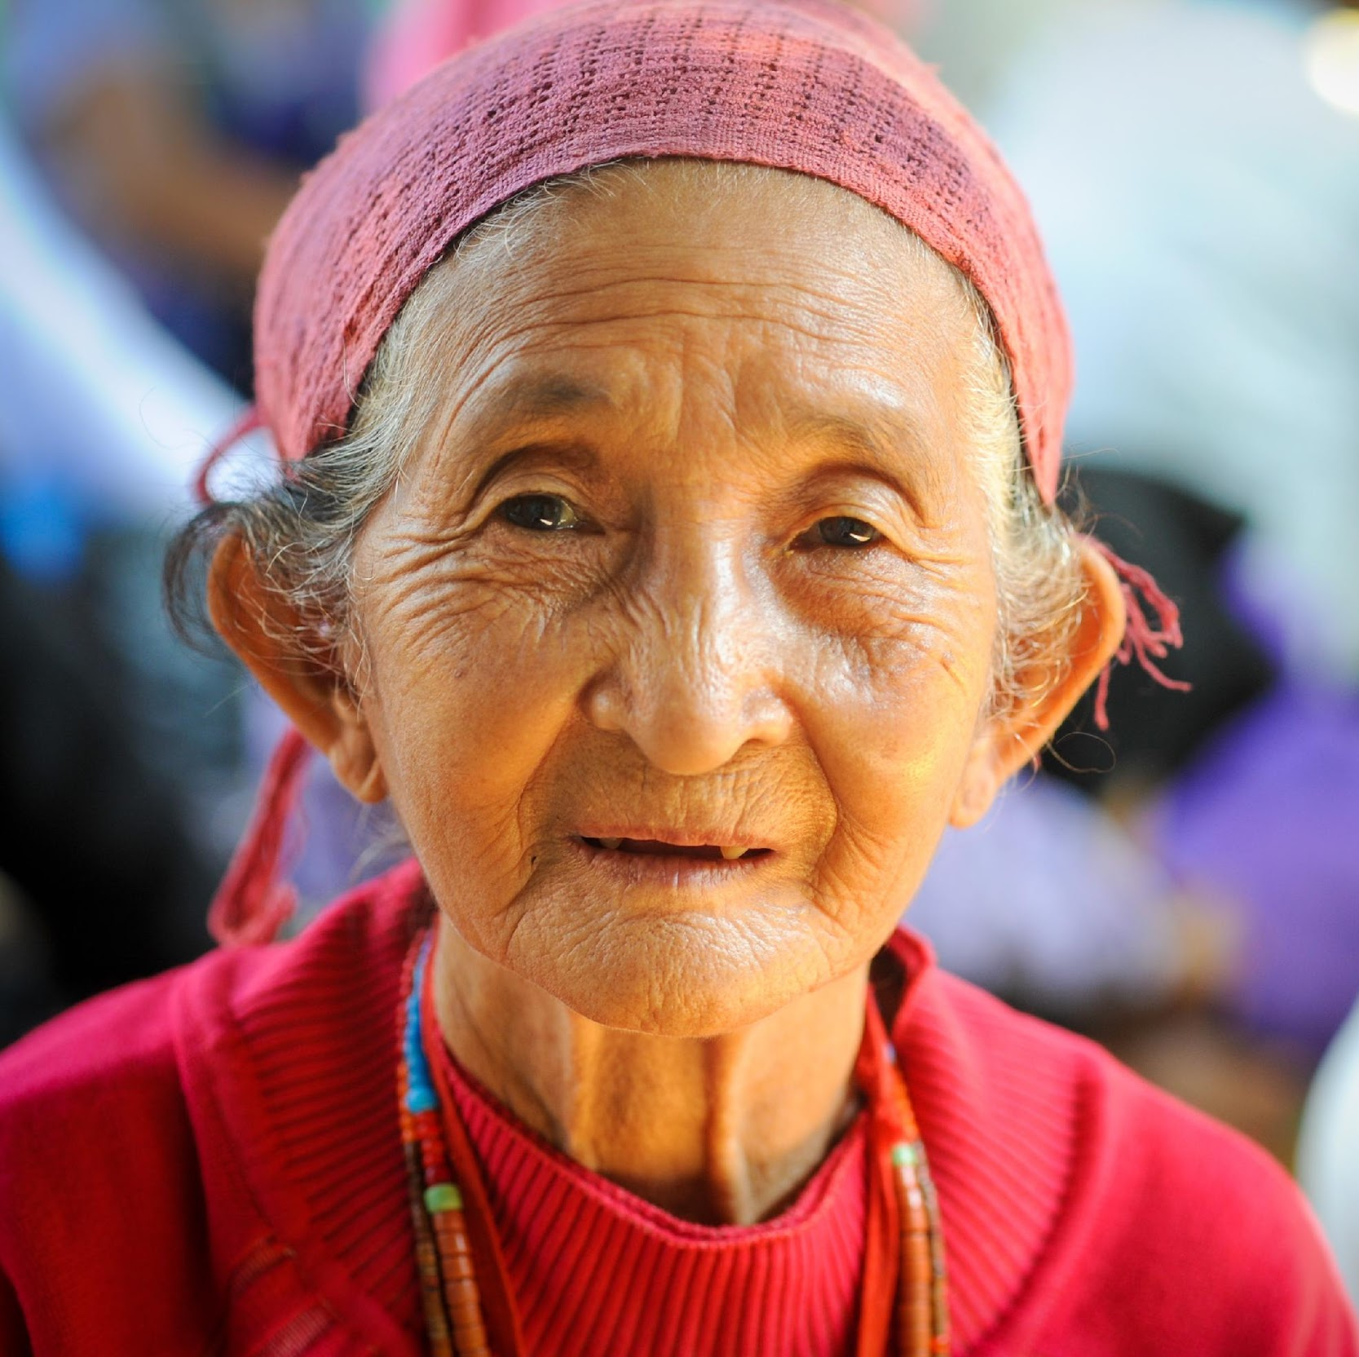
𐴁𐴟𐴌𐴝𐴔𐴝𐴕𐴟𐴐𐴥
𐴁𐴟𐴌𐴝𐴔𐴝𐴕𐴐𐴡𐴃𐴧𐴟𐴕 𐴋𐴝𐴄𐴧𐴡𐴌 𐴓𐴝𐴒𐴠 𐴑𐴟𐴊𐴟𐴌𐴡𐴃𐴧𐴡𐴌 𐴁𐴞𐴘𐴝𐴌𐴝𐴕𐴔𐴝𐴓𐴧𐴝
Notes:
𐴁𐴟𐴌𐴝𐴔𐴝𐴕𐴐𐴡𐴃𐴧𐴟𐴕 𐴋𐴝𐴄𐴧𐴡𐴌 𐴓𐴝𐴒𐴠 𐴑𐴟𐴊𐴟𐴌𐴡𐴃𐴧𐴡𐴌 𐴁𐴞𐴘𐴝𐴌𐴝𐴕𐴔𐴝𐴓𐴧𐴝

Slide 23
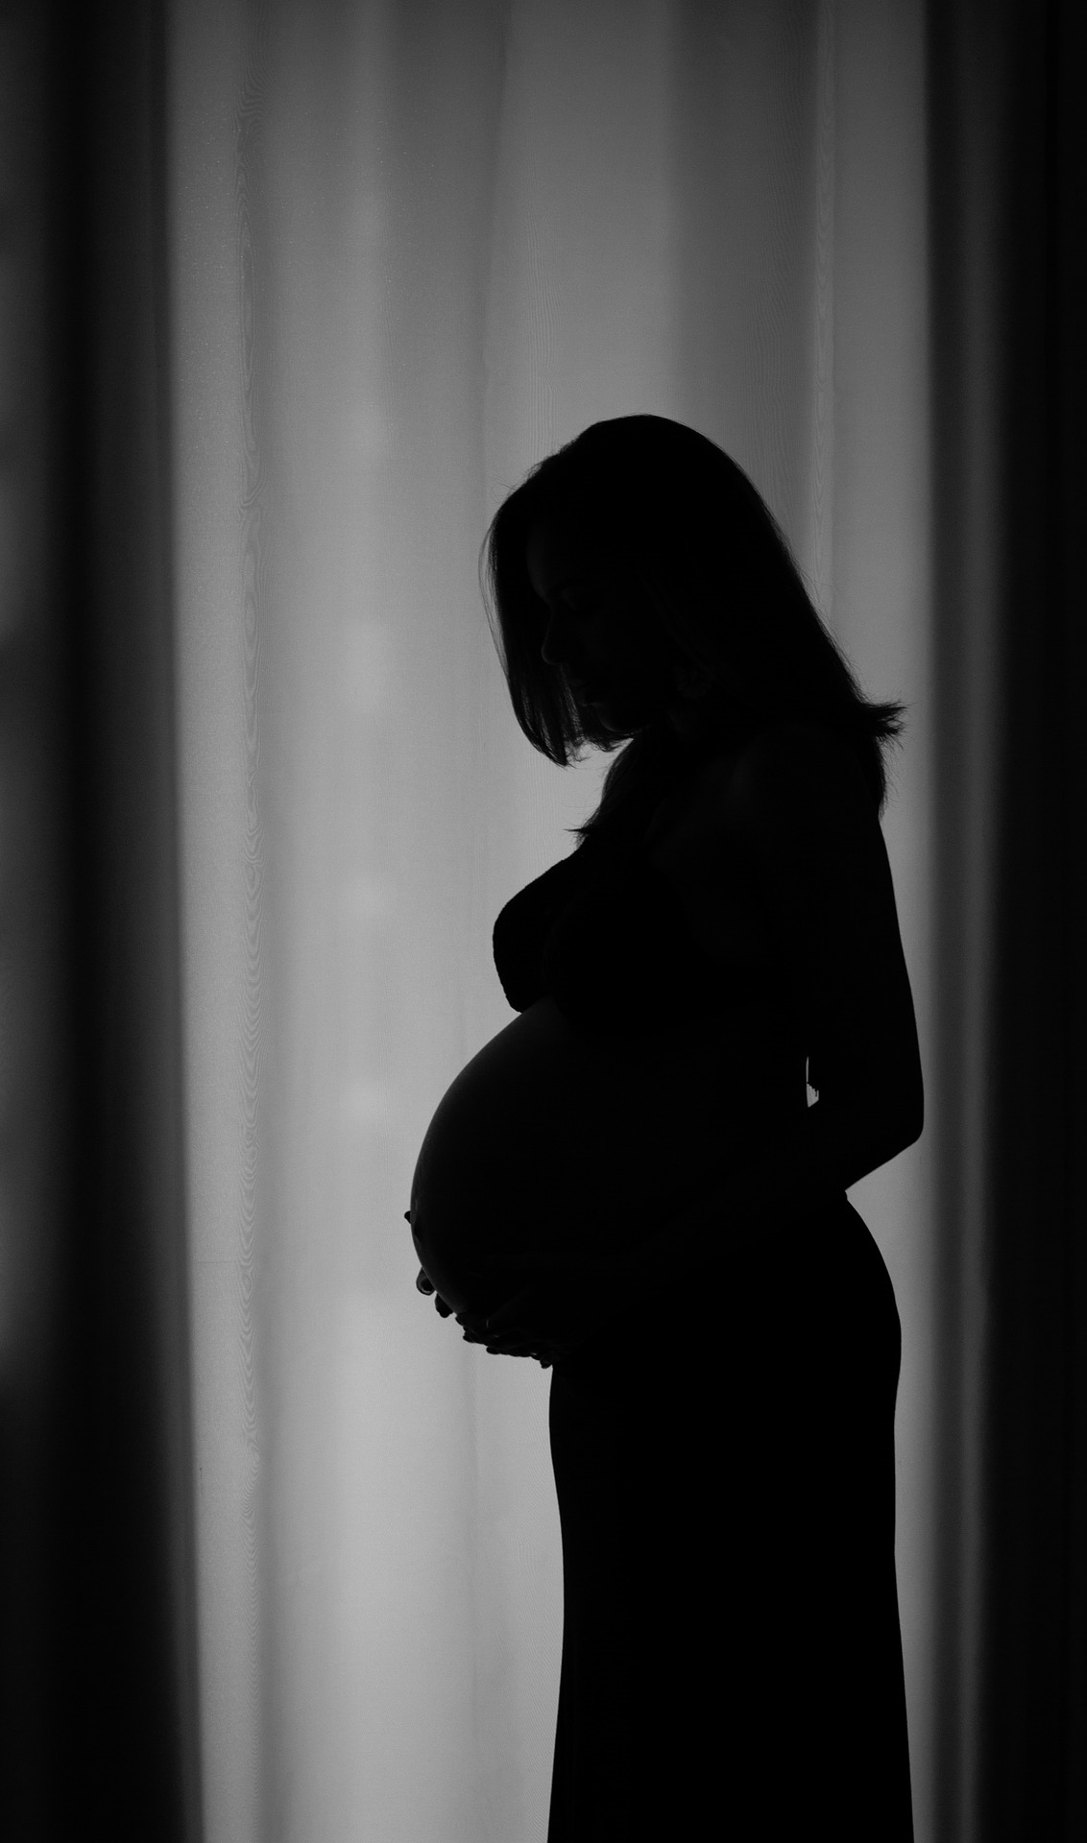
𐴈𐴝𐴔𐴞𐴓 𐴖𐴝𐴓𐴝 𐴔𐴝𐴘𐴝𐴉𐴟𐴖𐴝𐴕 𐴀𐴝𐴌 𐴓𐴝𐴔𐴁𐴝𐴄𐴙𐴝𐴔 𐴁𐴞𐴘𐴝𐴌𐴙𐴝𐴔𐴧𐴝
𐴄𐴞𐴑𐴒𐴡𐴌𐴞 𐴊𐴝𐴁𐴙𐴝𐴘 𐴒𐴡𐴌𐴞 𐴕𐴡𐴉𐴙𐴝𐴓𐴧𐴝 𐴀𐴡𐴐𐴝𐴕𐴃𐴞𐴓𐴝𐴒𐴠𐴥
Notes:
𐴈𐴝𐴔𐴞𐴓 𐴖𐴝𐴓𐴝 𐴔𐴝𐴘𐴝𐴉𐴟𐴖𐴝𐴕 𐴀𐴝𐴌 𐴓𐴝𐴔𐴁𐴝𐴄𐴙𐴝𐴔 𐴁𐴞𐴘𐴝𐴌𐴙𐴝𐴔𐴧𐴝 𐴄𐴞𐴑𐴒𐴡𐴌𐴞 𐴊𐴝𐴁𐴙𐴝𐴘 𐴒𐴡𐴌𐴞 𐴕𐴡𐴉𐴙𐴝𐴓𐴧𐴝 𐴀𐴡𐴐𐴝𐴕𐴃𐴞𐴓𐴝𐴒𐴠𐴥

Slide 24
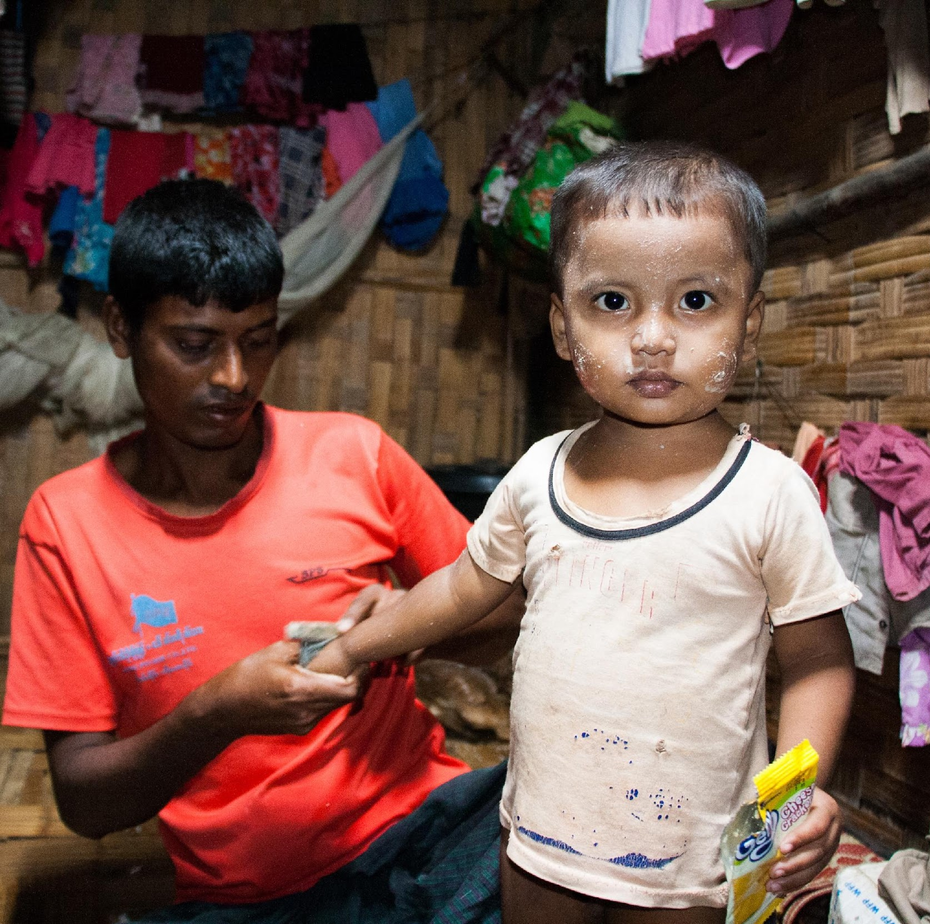
𐴒𐴡𐴌𐴝𐴉𐴟𐴖𐴝𐴕 𐴅𐴟𐴖𐴝𐴕𐴉𐴟𐴖𐴝𐴕 𐴀𐴝𐴌 𐴃𐴝𐴌𐴝𐴌𐴌𐴥 𐴎𐴞𐴔𐴧𐴝𐴊𐴝𐴌
𐴒𐴡𐴌𐴝𐴉𐴟𐴖𐴝𐴕 𐴀𐴡𐴑𐴧𐴡𐴓 𐴉𐴡𐴕𐴧𐴝𐴃𐴟𐴕 𐴔𐴝𐴌𐴟𐴀𐴙𐴝𐴘 𐴎𐴞𐴔𐴝𐴧𐴝𐴊𐴝𐴌𐴡𐴌 𐴉𐴟𐴎𐴝𐴁𐴡𐴕𐴞𐴎𐴝𐴒𐴡𐴘
Notes:
𐴒𐴡𐴌𐴝𐴉𐴟𐴖𐴝𐴕 𐴅𐴟𐴖𐴝𐴕𐴉𐴟𐴖𐴝𐴕 𐴀𐴝𐴌 𐴃𐴝𐴌𐴝𐴌𐴌𐴥 𐴎𐴞𐴔𐴧𐴝𐴊𐴝𐴌 𐴒𐴡𐴌𐴝𐴉𐴟𐴖𐴝𐴕 𐴀𐴡𐴑𐴧𐴡𐴓 𐴉𐴡𐴕𐴧𐴝𐴃𐴟𐴕 𐴔𐴝𐴌𐴟𐴀𐴙𐴝𐴘 𐴎𐴞𐴔𐴝𐴧𐴝𐴊𐴝𐴌𐴡𐴌 𐴉𐴟𐴎𐴝𐴁𐴡𐴕𐴞𐴎𐴝𐴒𐴡𐴘

Slide 25
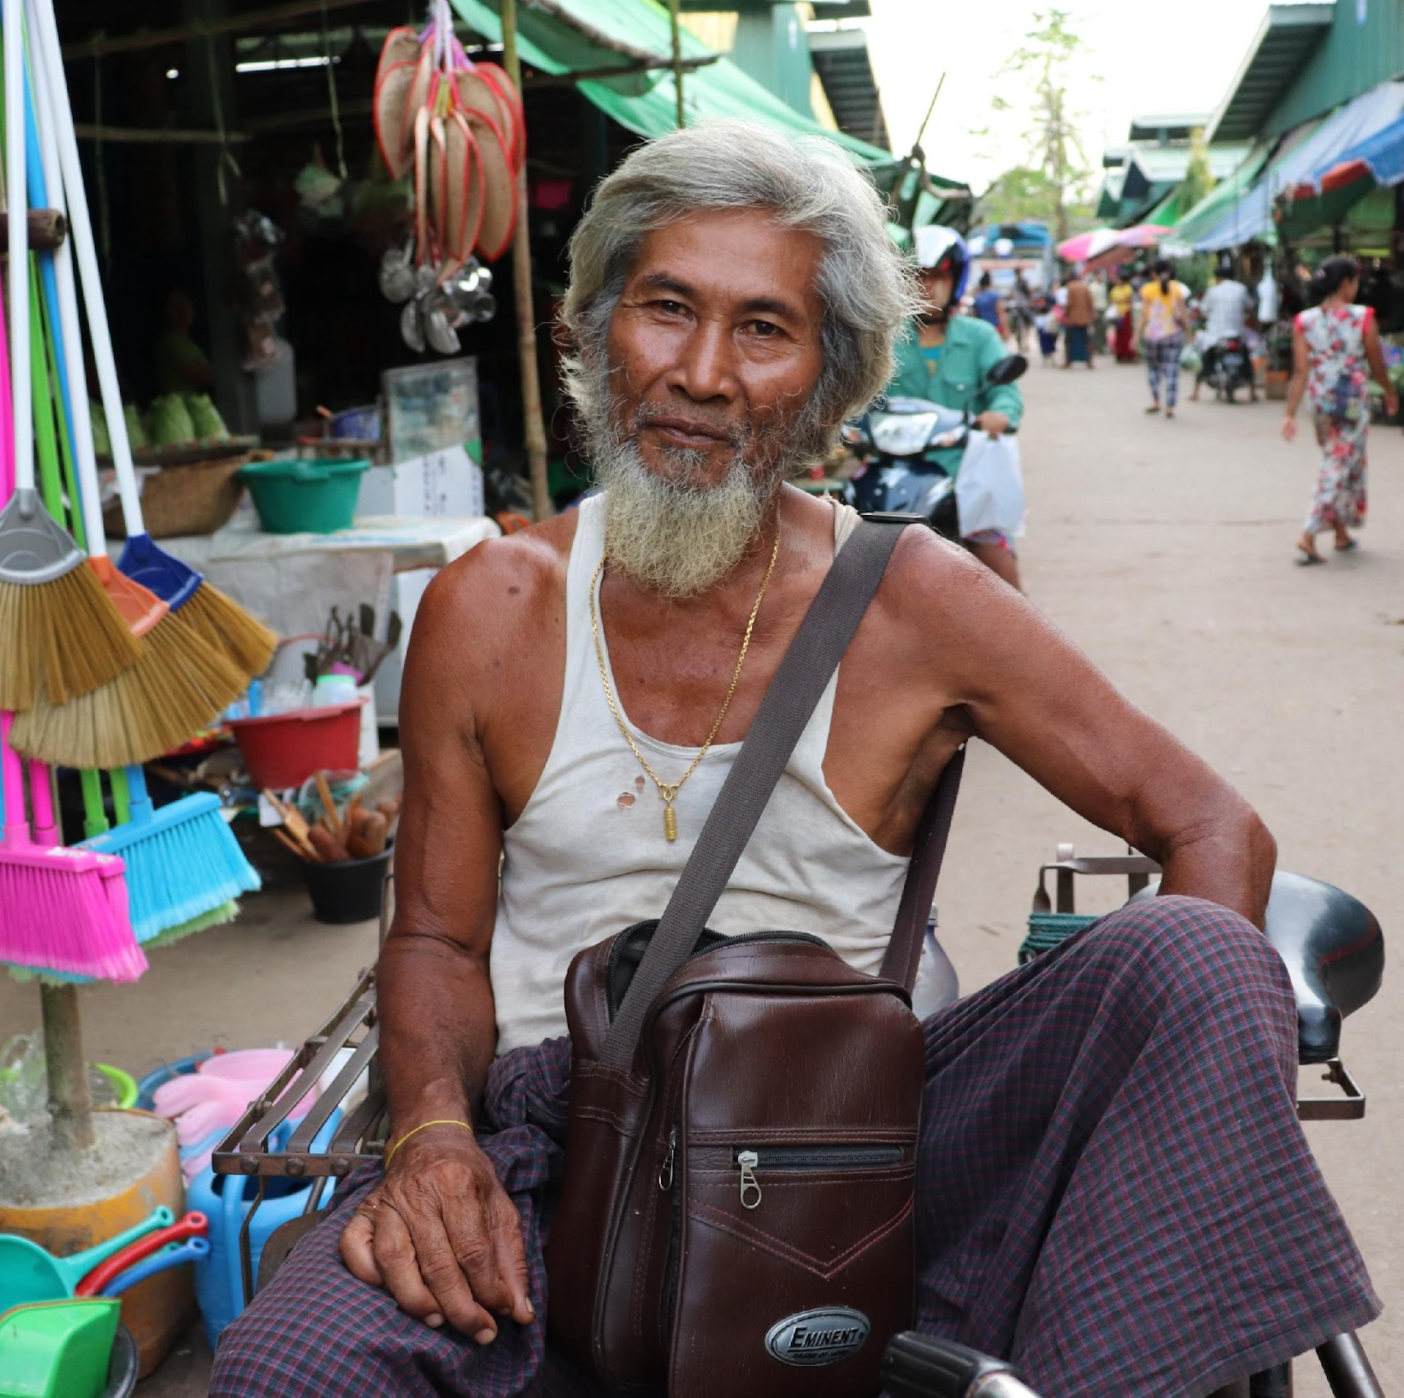
𐴒𐴡𐴌𐴏𐴝𐴌𐴝 𐴔𐴝𐴕𐴟𐴙𐴐
𐴌𐴝𐴏𐴧𐴧𐴝𐴃𐴢 𐴀𐴠𐴊𐴠 𐴄𐴡𐴚𐴧𐴧𐴧𐴡𐴃𐴢 𐴃𐴝𐴝𐴑𐴠𐴊𐴠 𐴔𐴝𐴕𐴟𐴙𐴐 𐴀𐴠𐴕𐴧𐴞𐴕 𐴔𐴡𐴏𐴞𐴁𐴡𐴃𐴡𐴊 𐴃𐴝𐴑𐴠
Notes:
𐴒𐴡𐴌𐴏𐴝𐴌𐴝 𐴔𐴝𐴕𐴟𐴙𐴐 𐴌𐴝𐴏𐴧𐴧𐴝𐴃𐴢 𐴀𐴠𐴊𐴠 𐴄𐴡𐴚𐴧𐴧𐴧𐴡𐴃𐴢 𐴃𐴝𐴝𐴑𐴠𐴊𐴠 𐴔𐴝𐴕𐴟𐴙𐴐 𐴀𐴠𐴕𐴧𐴞𐴕 𐴔𐴡𐴏𐴞𐴁𐴡𐴃𐴡𐴊 𐴃𐴝𐴑𐴠

Slide 26
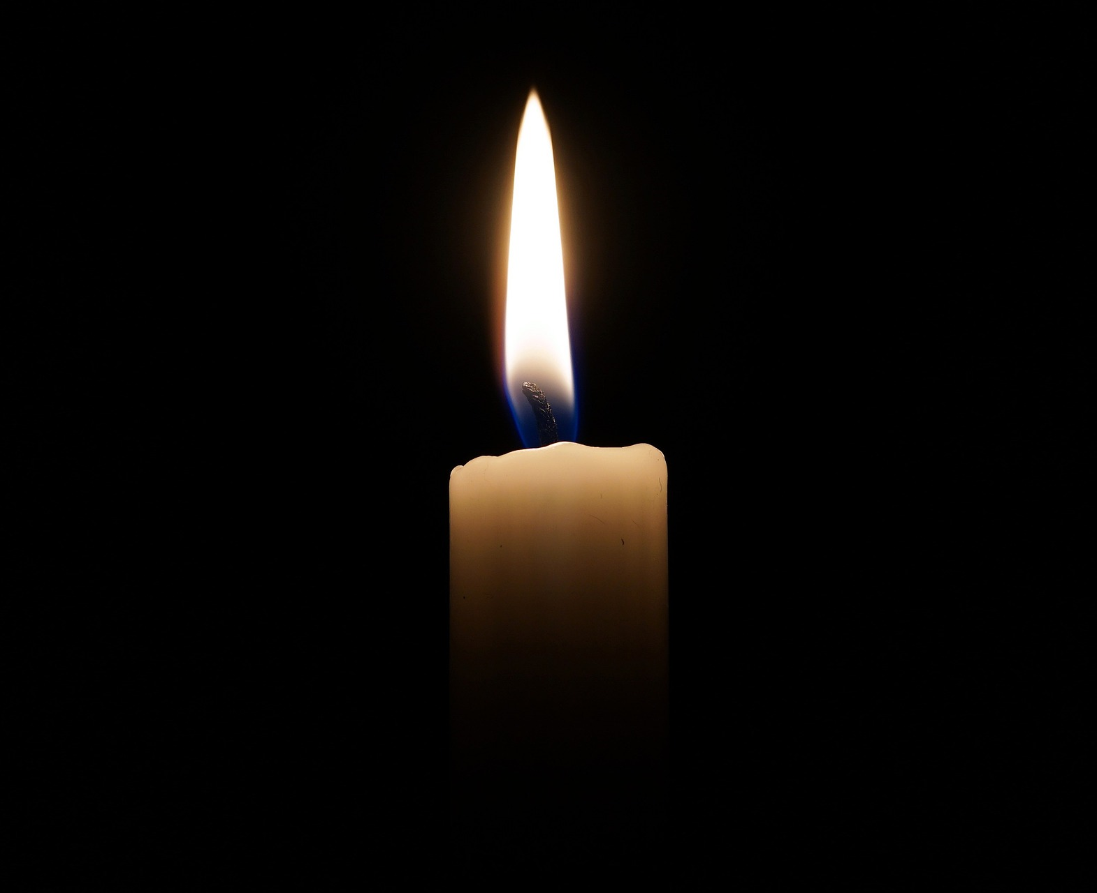
𐴏𐴞𐴃𐴝𐴒𐴡𐴌𐴠𐴊𐴠 𐴔𐴝𐴕𐴟𐴙𐴥𐴐 𐴀𐴡𐴑𐴧𐴡𐴓
𐴏𐴞𐴃𐴝𐴒𐴡𐴌𐴠𐴊𐴠 𐴔𐴝𐴕𐴟𐴙𐴐 𐴀𐴡𐴑𐴧𐴡𐴓𐴧𐴡𐴌 𐴏𐴞𐴃𐴝 𐴎𐴝𐴌𐴞𐴕𐴝𐴉𐴝𐴌𐴞
𐴏𐴞𐴃𐴝 𐴎𐴝𐴌𐴞 𐴀𐴡𐴘𐴃𐴝𐴑𐴠𐴦
Notes:
𐴏𐴞𐴃𐴝𐴒𐴡𐴌𐴠𐴊𐴠 𐴔𐴝𐴕𐴟𐴙𐴥𐴐 𐴀𐴡𐴑𐴧𐴡𐴓 𐴏𐴞𐴃𐴝𐴒𐴡𐴌𐴠𐴊𐴠 𐴔𐴝𐴕𐴟𐴙𐴐 𐴀𐴡𐴑𐴧𐴡𐴓𐴧𐴡𐴌 𐴏𐴞𐴃𐴝 𐴎𐴝𐴌𐴞𐴕𐴝𐴉𐴝𐴌𐴞 𐴏𐴞𐴃𐴝 𐴎𐴝𐴌𐴞 𐴀𐴡𐴘𐴃𐴝𐴑𐴠𐴦

Slide 27
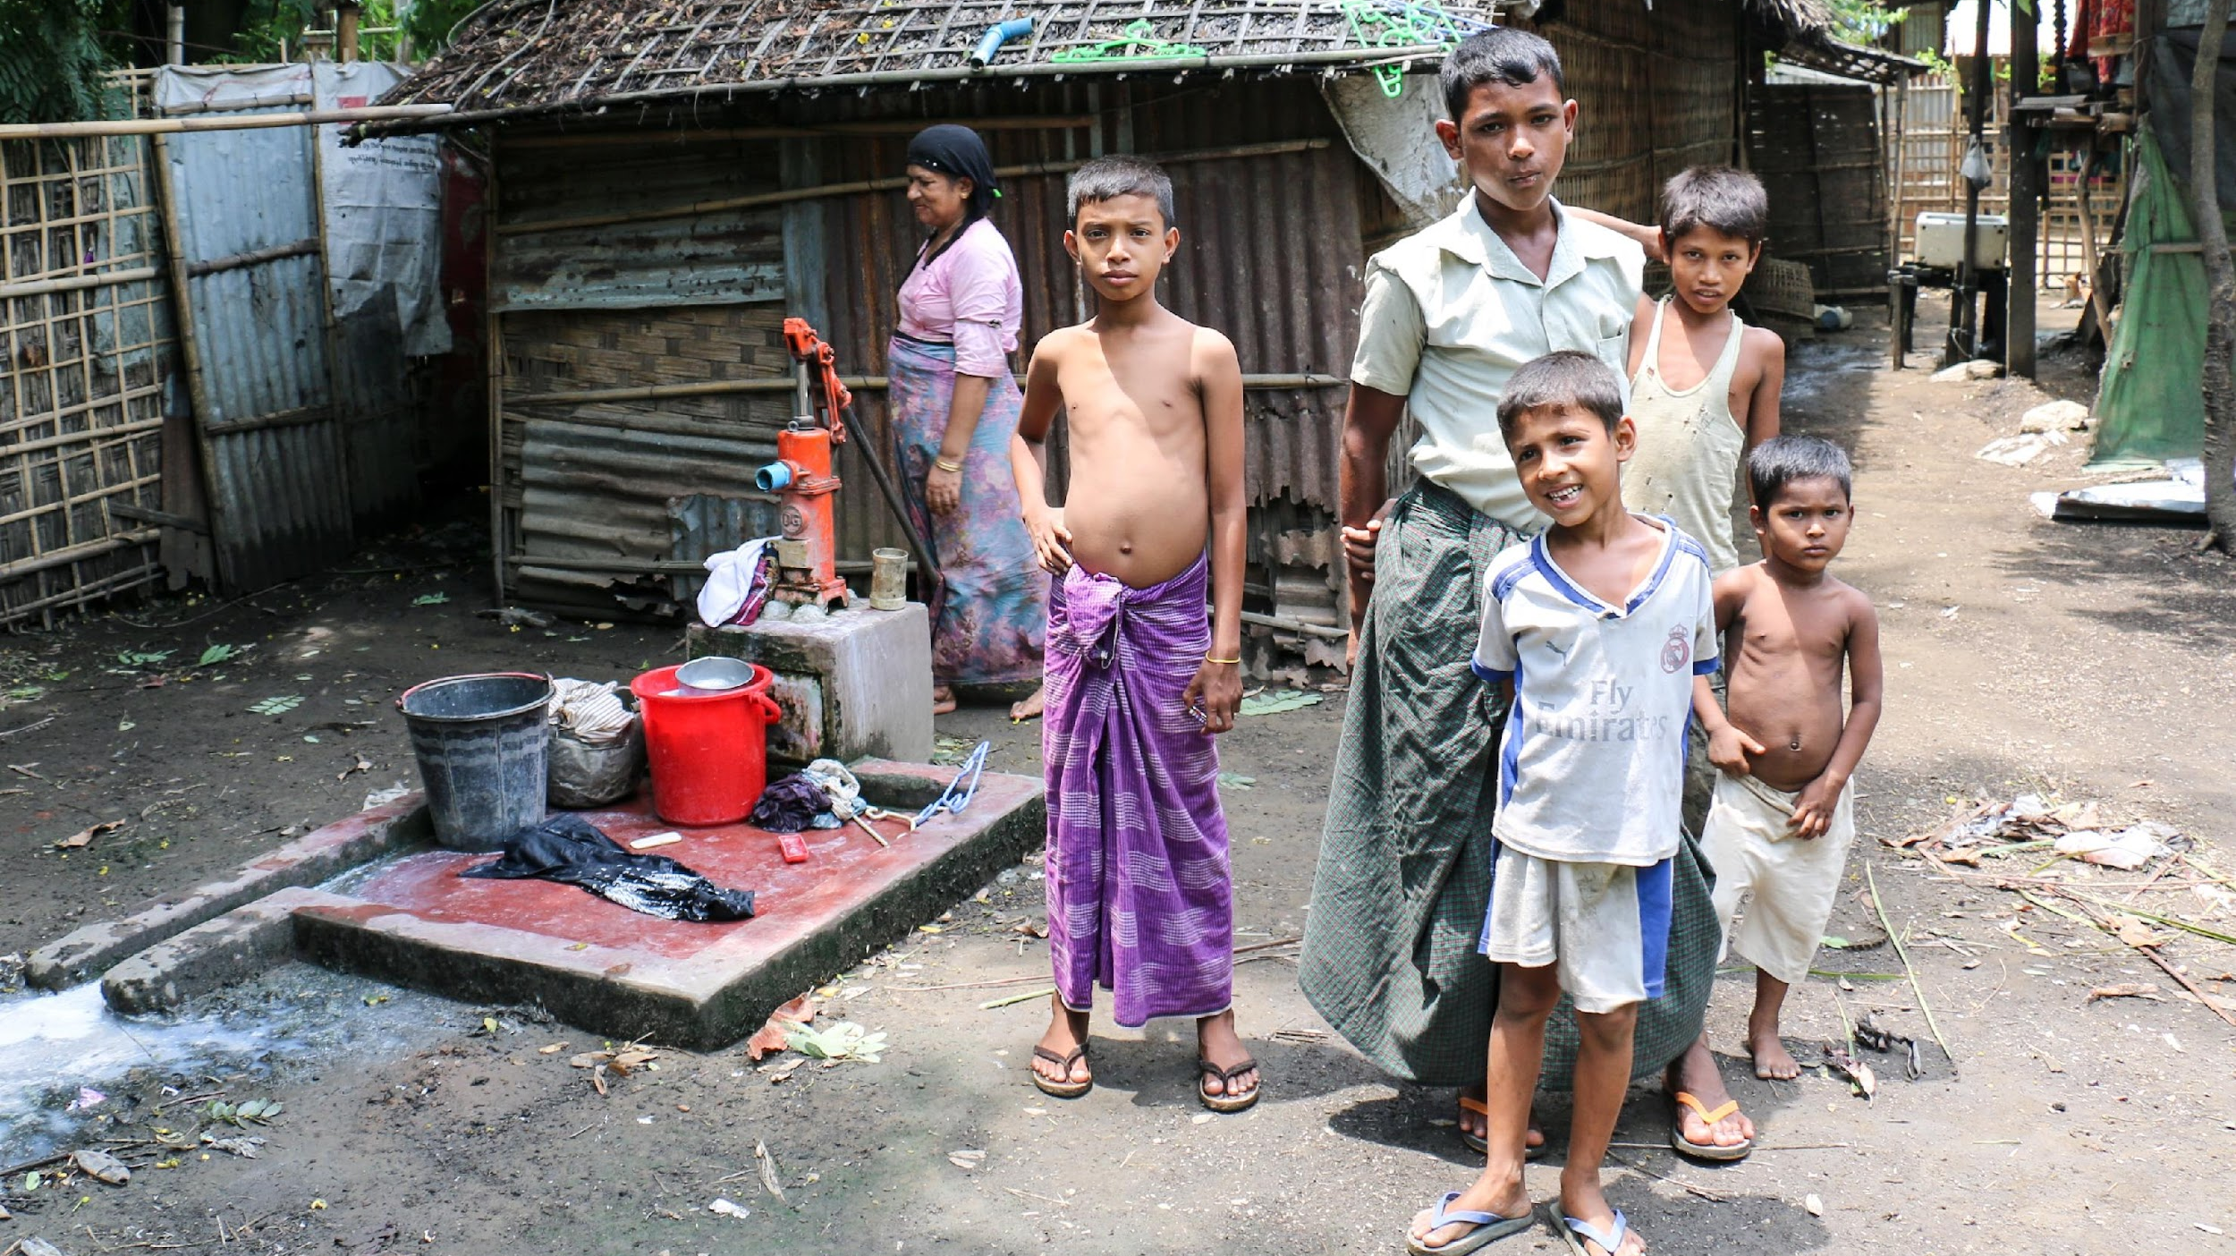
𐴎𐴝𐴌𐴝𐴤 𐴄𐴝𐴓𐴡𐴄 𐴃𐴝𐴑𐴠𐴤
𐴇𐴞𐴃𐴝𐴌𐴝𐴃𐴟𐴕𐴥 𐴃𐴟𐴅𐴟𐴌𐴟𐴃𐴝 𐴃𐴝𐴑𐴠𐴤𐴤 𐴈𐴡𐴑𐴟𐴔𐴟𐴃𐴧𐴟𐴌 𐴔𐴝𐴕𐴝𐴌𐴠

Slide 28
Module 5
𐴑𐴡𐴔𐴎𐴟𐴌 𐴔𐴙𐴝𐴕𐴐𐴡𐴌𐴠 𐴔𐴡𐴊𐴡𐴃 𐴒𐴡𐴌𐴡𐴕
Notes:
𐴑𐴡𐴔𐴎𐴟𐴌 𐴔𐴙𐴝𐴕𐴐𐴡𐴌𐴠 𐴔𐴡𐴊𐴡𐴃 𐴒𐴡𐴌𐴡𐴕 𐴃𐴡𐴌𐴞𐴑𐴝𐴤

Slide 29
𐴑𐴡𐴔𐴎𐴟𐴌 𐴔𐴙𐴝𐴕𐴐𐴡𐴌𐴓𐴡𐴙𐴘𐴥 𐴊𐴟𐴓𐴝𐴦𐴀𐴡𐴘𐴥𐴓𐴠 𐴑𐴞𐴒𐴡𐴥𐴌𐴞𐴁𐴝𐴤
Notes:
𐴑𐴡𐴔𐴎𐴟𐴌 𐴔𐴙𐴝𐴕𐴐𐴡𐴌𐴓𐴡𐴙𐴘𐴥 𐴊𐴟𐴓𐴝𐴦𐴀𐴡𐴘𐴥𐴓𐴠 𐴑𐴞𐴒𐴡𐴥𐴌𐴞𐴁𐴝𐴤

Slide 30
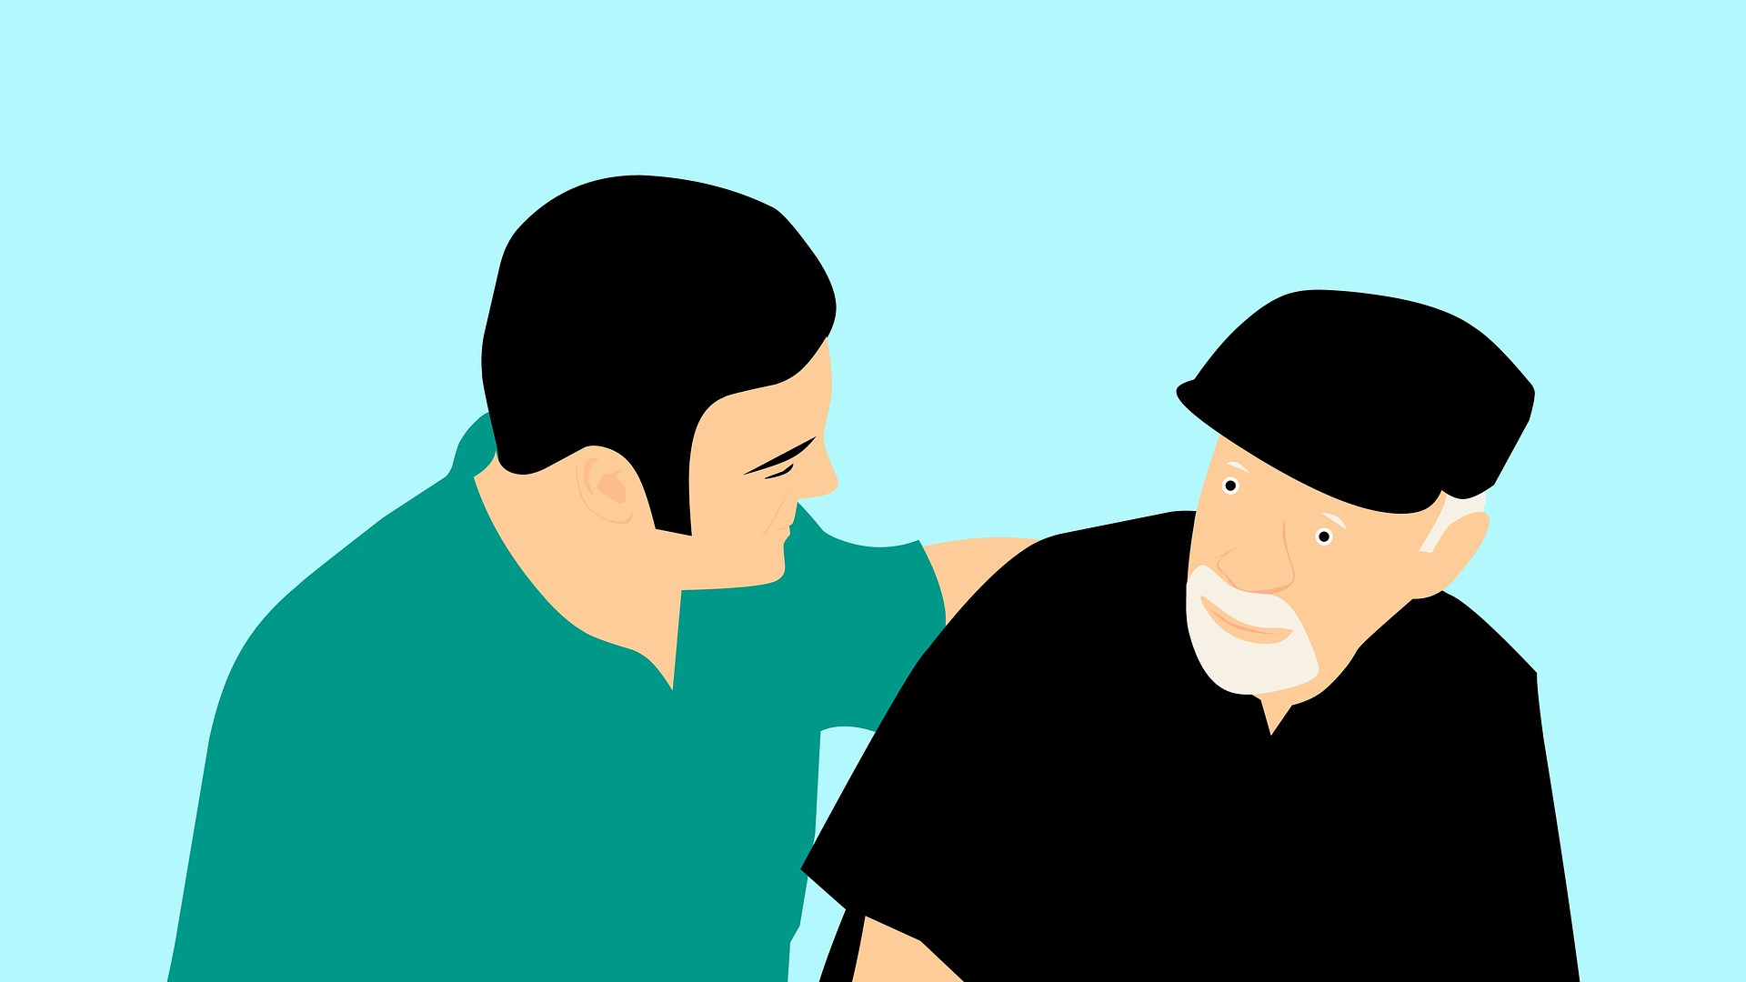
𐴃𐴟𐴣𐴖𐴝𐴌 𐴔𐴟𐴊𐴡𐴃𐴧𐴡𐴌𐴠 𐴊𐴝𐴇𐴙𐴝𐴘𐴁𐴡𐴓𐴧𐴝 𐴃𐴟𐴣𐴘 𐴑𐴞𐴒𐴡𐴌𐴞𐴁𐴝
Notes:
𐴃𐴟𐴣𐴖𐴝𐴌 𐴔𐴟𐴊𐴡𐴃𐴧𐴡𐴌𐴠 𐴊𐴝𐴇𐴙𐴝𐴘𐴁𐴡𐴓𐴧𐴝 𐴃𐴟𐴣𐴘 𐴑𐴞𐴒𐴡𐴌𐴞𐴁𐴝

Slide 31
𐴀𐴝𐴇𐴡𐴓 𐴁𐴟𐴊𐴧𐴞 𐴊𐴡𐴓𐴝𐴒𐴡𐴌𐴞 𐴐𐴟𐴕𐴊𐴡𐴌𐴥
𐴒𐴡𐴌𐴞 𐴔𐴡𐴊𐴡𐴃𐴢𐴒𐴡𐴌𐴞𐴁𐴡𐴓𐴧𐴝
Notes:
𐴀𐴝𐴇𐴡𐴓 𐴁𐴟𐴊𐴧𐴞 𐴊𐴡𐴓𐴝𐴒𐴡𐴌𐴞 𐴐𐴟𐴕𐴊𐴡𐴌𐴥 𐴒𐴡𐴌𐴞 𐴔𐴡𐴊𐴡𐴃𐴢𐴒𐴡𐴌𐴞𐴁𐴡𐴓𐴧𐴝

Slide 32
𐴑𐴡𐴔𐴎𐴟𐴌 𐴔𐴝𐴕𐴙𐴝𐴐 𐴀𐴡𐴑𐴧𐴡𐴓𐴧𐴡𐴌𐴠 𐴃𐴟𐴖𐴡𐴤 𐴀𐴝𐴌𐴥 𐴇𐴞𐴃𐴝𐴌𐴝𐴌𐴠 𐴔𐴡𐴊𐴡𐴃 𐴇𐴡𐴌𐴠𐴒𐴡𐴌𐴠𐴊𐴧𐴠 𐴊𐴝𐴇𐴝𐴘𐴤𐴊𐴡𐴥𐴥
Notes:
𐴑𐴡𐴔𐴎𐴟𐴌 𐴔𐴝𐴕𐴙𐴝𐴐 𐴀𐴡𐴑𐴧𐴡𐴓𐴧𐴡𐴌𐴠 𐴃𐴟𐴖𐴡𐴤 𐴀𐴝𐴌𐴥 𐴇𐴞𐴃𐴝𐴌𐴝𐴌𐴠 𐴔𐴡𐴊𐴡𐴃 𐴇𐴡𐴌𐴠𐴒𐴡𐴌𐴠𐴊𐴧𐴠 𐴊𐴝𐴇𐴝𐴘𐴤𐴊𐴡𐴥𐴥

Slide 33
𐴊𐴝𐴇𐴝𐴘𐴊𐴡 𐴃𐴝𐴌𐴝𐴌𐴠 𐴔𐴡𐴊𐴡𐴃𐴧𐴡𐴌 𐴋𐴙𐴝𐴘𐴌𐴠 𐴀𐴝𐴌𐴥 𐴔𐴡𐴊𐴡𐴃𐴡𐴌𐴥 𐴒𐴟𐴎𐴧𐴝𐴤𐴌𐴠𐴥 𐴃𐴝𐴌𐴝𐴌 𐴀𐴠𐴎𐴝𐴎𐴡𐴃𐴓𐴡𐴘𐴥
Notes:
𐴊𐴝𐴇𐴝𐴘𐴊𐴡 𐴃𐴝𐴌𐴝𐴌𐴠 𐴔𐴡𐴊𐴡𐴃𐴧𐴡𐴌 𐴋𐴙𐴝𐴘𐴌𐴠 𐴀𐴝𐴌𐴥 𐴔𐴡𐴊𐴡𐴃𐴡𐴌𐴥 𐴒𐴟𐴎𐴧𐴝𐴤𐴌𐴠𐴥 𐴃𐴝𐴌𐴝𐴌 𐴀𐴠𐴎𐴝𐴎𐴡𐴃𐴓𐴡𐴘𐴥

Slide 34
Module 5 𐴐𐴠𐴐𐴦
Next: Module 6
Notes:
Module 5 𐴐𐴠𐴐𐴦 𐴀𐴠 Module 𐴔𐴝𐴎𐴠𐴥 𐴀𐴝𐴣𐴀𐴌𐴝 𐴔𐴡𐴐𐴝𐴌𐴝 𐴒𐴡𐴎𐴧𐴞 𐴏𐴡𐴘𐴞 𐴇𐴝𐴓𐴡𐴃𐴧𐴡𐴌 𐴀𐴡𐴌𐴠 𐴔𐴡𐴊𐴡𐴊𐴥 𐴒𐴡𐴌𐴞𐴁𐴡𐴓𐴧𐴝

